Slide 1
Core Strategies of Brief Solution-Focused Counseling in Schools: A Toolbox of Practical Techniques
John J. Murphy, Ph.D.
Translating Research into Practice
University of Central Arkansas (USA)
E: jmurphy@uca.edu Web: www.drjohnmurphy.com
Participants will learn practical skills and strategies to help them:
1. Build collaborative, culturally responsive alliances with students and others.
2. Shift from problem talk to solution talk.
3. Develop practical goals that matter to students.
4. Identify and build on exceptions to the problem.
Washington State Association of School Psychologists (WSASP)
January 27th, 2017: 9am-12pm PST

Slide 2
Main Tasks of Brief Solution-Focused Counseling*
Involve people in every aspect of their care to the extent that they are willing and able to participate (build collaborative, culturally responsive relationships)
Clarify people’s desired future and develop goals (clarify what people want from services and develop practical goals that matter)
Build on what is “right” with people; invite them to try something different (build on what people already do (exceptions) and already have (natural resources) to help them reach their goals; invite them to try something different by changing the viewing or doing)
Empower progress (invite people to notice, own, explain, and sustain desired changes)
*These tasks and methods apply to working with children, adolescents, parents, teachers, families, and others, and to any change-focused activity including problem-solving teams, group work, consultation, systems change, supervision, teaching, etc.

Slide 3
The Change Pie: Core Ingredients of Effective Counseling (and their Percentage Contribution to Successful Outcomes) (based on 1000+ research studies; Lambert & Ogles, 2004)
Successful outcomes depend largely on the extent to which the practitioner respects and builds on people’s resources and input (client factors), forms a strong alliance (relationship factors), instills hope (hope factors), and uses techniques that mobilize all these ingredients (technique factors). (Handout)

Slide 4
Quick Exercise: What Would You Want? (Individually or in small groups)
Instructions: Take a moment to reflect on the following situation and questions:
The Situation: Imagine that you are assigned to talk to someone you’ve never met about something that you find uncomfortable, embarrassing, or shameful. You are nervous about how this person will view you and treat you.
The Questions:
What would you need from them in order to talk openly and honestly about your concern?
How would you want them to relate to you?
What might they say or do that would convince you that it would be okay (or even helpful) to talk with them about it?
Adapted from: Madsen, W. C., & Gillespie, K. Collaborative helping. Hoboken, NJ: Wiley.

Slide 5
Involve People by Building Collaborative, Culturally Responsive Relationships
Adopt the “ambassador mindset” by approaching every interaction as a cross-cultural experience and every person as a culture of one.
Listen to/validate people and their struggles
Ask questions from a position of “not knowing” and “respectful curiosity” (cultural humility)
Compliment people for “what’s right” in themselves and their lives
Collect feedback at every contact (PCOMS)
www.heartandsoulofchange.com

Slide 6
Involve People by Building Collaborative, Culturally Responsive Relationships
Adopt the “ambassador mindset” by approaching every interaction as a cross-cultural experience and every person as a culture of one.
Listen to/validate people and their struggles
Ask questions from a position of “not knowing” and “respectful curiosity” (cultural humility) (Videos)
Compliment people for “what’s right” in themselves and their lives
Collect feedback at every contact (PCOMS)
www.heartandsoulofchange.com

Slide 7
Family (single mother, two sons/parent-child conflict):
Approaching people from a position of “not knowing” and humility; requiring their help in order to be useful

Slide 8
Homeless shelter client (Anthony, age 20):
Approaching clients with cultural humility (leveling the helping relationship by “asking permission”)

Slide 9
Parent Consultation: Orienting Comments (“I need your help; I want to be useful to you; I will need to ask questions…”)

Slide 10
Involve People by Building Collaborative, Culturally Responsive Relationships
Adopt the “ambassador mindset” by approaching every interaction as a cross-cultural experience and every person as a culture of one.
Listen to/validate people and their struggles
(Videos: Molly, age 10)*
Ask questions from a position of “not knowing” and “respectful curiosity” (cultural humility)
Compliment people for “what’s right” in themselves and their lives
Collect feedback at every contact (PCOMS)
www.heartandsoulofchange.com

Slide 11
Molly (age 10): The importance of listening to and validating people’s struggles and opinions

Slide 12
Molly (age 10): The importance of listening to and validating people’s struggles and opinions

Slide 13
Involve People by Building Collaborative, Culturally Responsive Relationships
Adopt the “ambassador mindset” by approaching every interaction as a cross-cultural experience and every person as a culture of one.
Listen to/validate people and their struggles
Ask questions from a position of “not knowing” and “respectful curiosity” (cultural humility)
Compliment people for “what is right” in themselves and their lives Video: Single mother; young man from homeless shelter)*
Collect feedback at every contact (PCOMS)
www.heartandsoulofchange.com

Slide 14
Folding Compliments into Questions (Anthony)

Slide 15
Quick Exercise: Giving Compliments (Individually or in Pairs/Small Groups)
Instructions
In Pairs/Small Groups: Have one person in the group share a recent accomplishment (not too dramatic, just something you were pleased with), then others offer compliments that are direct (referring to people’s actions), indirect (folding compliments into questions), or attribution-based (referring to people’s positive attributes). Switch roles to give more people a chance to practice giving compliments.
Individually: Think of a student or someone else you know who has achieved a recent accomplishment (not too dramatic, just something they were pleased with), and practice giving one or more compliments as described above. When you finish with one person, think of another and offer compliment to that person.

Slide 16
Involve People by Building Collaborative, Culturally Responsive Relationships
Adopt the “ambassador mindset” by approaching every interaction as a cross-cultural experience and every person as a culture of one.
Listen to/validate people and their struggles
Ask questions from a position of “not knowing” and “respectful curiosity” (cultural humility)
Compliment people for “what is right” in themselves and their lives
Collect feedback at every contact (PCOMS)
www.heartandsoulofchange.com

Slide 17
Rationale for Collecting Client Feedback
Client-driven vs. agency driven
Importance of early change and alliance
Practitioners are poor judges of negative outcomes
Collaboration enhances change; client feedback operationalizes collaboration by involving clients in all major decisions and aspects of counseling—goals, content, and practitioner’s approach.
Obtaining and discussing client feedback about the client’s progress and the fit of services (alliance)—and using this information to enhance what is working and change what is not working—consistently improves counseling outcomes (sometimes as much as doubling the practitioner’s effectiveness)…compelling research support (multiple RCTs, …)

Slide 18
Collect client feedback at every contact
Purpose: give people a voice; monitor and adjust services
Informal scaling questions (“On a scale of 0 to 10, ...”)
Formal, ultra-brief rating scales from Partners for Change Outcome Management System (PCOMS)
Begin session with Outcome Rating Scale (ORS/CORS)
End session with Session Rating Scale (SRS/CSRS)
Purpose: give people a voice; monitor and adjust services
For more info on PCOMS and these measures:
www.heartandsoulofchange.com
*Video examples of collecting client feedback…

Slide 19
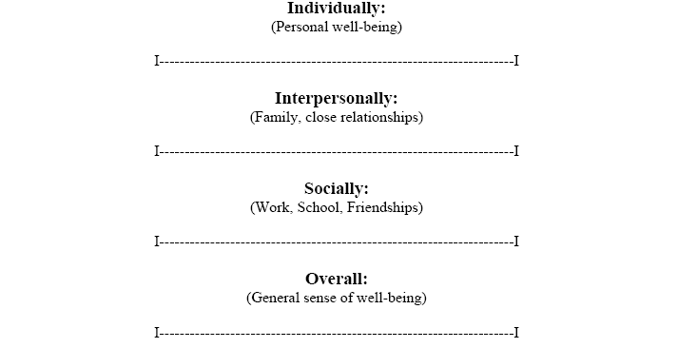
Outcome Rating Scale (ORS) (measures change and progress)
Give at the beginning of the visit; Client places a mark on the line.
Each line 10 cm (100 mm) in length.
Reliable, valid, practical
Scored to the nearest millimeter.
Add the four scales together for the total score.

Slide 20
Collecting Formal Client Feedback: Introducing the Outcome Rating Scale (ORS) to Monitor Progress and Give People A Voice in Their Services (Parent & Son)

Slide 21
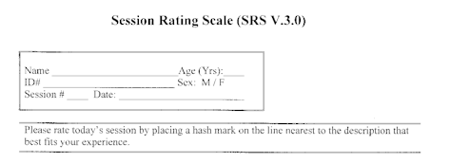
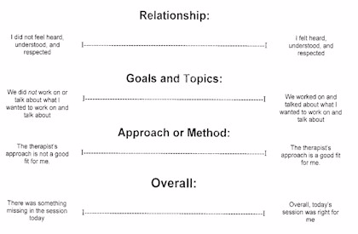
Session Rating Scale (SRS): Measuring the Alliance
Give at the end of session;
Each line 10 cm in length;
Reliable, valid, practical
Score in cm to the nearest mm;
Discuss with client anytime total score falls below 36
Detect and correct alliance problems

Slide 22
Collecting Formal Client Feedback: Introducing the Session Rating Scale (SRS) to Monitor Alliance and Give People A Voice in Their Services (Chelsea, age 16)

Slide 23
What Feedback is NOT…

Slide 24
Practice Exercise: Involve People by Building Collaborative, Culturally Responsive Relationships (Individually or in Pairs/Small Groups)
Instructions: Reflect on (individually) or discuss (in pairs/small groups) one or more of the following questions:
Which of the relationship strategies that we’ve discussed in this session have been especially helpful to you and the people you serve?
Which ones have been (or would be) more difficult for you to implement?
Which ones do you want to implement more often in your work?
What else, in addition to the strategies we’ve discussed, has been helpful in building strong relationships with the people you serve?

Slide 25
Clarify Desired Future & Develop Practical Goals
Clarify people’s desired future for life and from our services
What are your best hopes for life? From our meetings? (general vision of a good outcome—“My parents/teachers and I would get along better”); Why is that important to you?
Obtain a detailed description of the desired future
How will you know that our meetings is working? If we watched a movie of you and your parents (or teachers) getting along better, what would we see? (videotalk description)
Ask Miracle, Tomorrow, or Scaling Questions (If a miracle happened while you were asleep tonight and this problem vanished, how would you know in the morning? What would it look like if you woke up tomorrow and you and your parents/teachers were getting along better? If things with you and your parents/teachers are at a “3” now, what would a 3.1 look like?) [Self-Exercise & Video)
Develop Practical Goals (“Next Steps”) Using 5-S Guideline (Significant, Specific, Small, Start based, Self-manageable)

Slide 26
Self-Exercise: Obtaining a Detailed Description of the Client’s Desired Future
Self-Exercise: Ask yourself one or more of the following questions think of the future…
Best Hopes Questions (What are your best hopes for the future? From therapy? How will you know that you are achieving your hopes?)
Fast-Forward Questions (How will your life be different three months from now if our work is successful? What will you be doing differently? What will that be like for you?)
Tomorrow Questions (If you woke up tomorrow and your life was just as you wanted it to be/your hopes from therapy were achieved), what would you notice? What would be different?)
Miracle Questions (If a miracle happened while you were asleep tonight and your problem completely vanished, how would you know in the morning? What would you be doing differently?)

Slide 27
Clarify Desired Future & Develop Practical Goals
Clarify people’s desired future for life and from our services
What are your best hopes for life? From our meetings? (general vision of a good outcome—“My parents/teachers and I would get along better”); Why is that important to you?
Obtain a detailed description of the desired future
How will you know that our meetings is working? If we watched a movie of you and your parents (or teachers) getting along better, what would we see? (videotalk description)
Ask Miracle, Tomorrow, or Scaling Questions (If a miracle happened while you were asleep tonight and this problem vanished, how would you know in the morning? What would it look like if you woke up tomorrow and you and your parents/teachers were getting along better? If things with you and your parents/teachers are at a “3” now, what would a 3.1 look like?) [Self-Exercise & Video)
Develop Practical Goals (“Next Steps”) Using 5-S Guideline (Significant, Specific, Small, Start based, Self-manageable)

Slide 28
Asking the Miracle Question & Exploring Related Details

Slide 29
Clarify Desired Future & Develop Practical Goals
Clarify people’s desired future for life and from our services
What are your best hopes for life? From our meetings? (general vision of a good outcome—“My parents/teachers and I would get along better”); Why is that important to you?
Obtain a detailed description of the desired future
How will you know that our meetings is working? If we watched a movie of you and your parents (or teachers) getting along better, what would we see? (videotalk description)
Ask Miracle, Tomorrow, or Scaling Questions (If a miracle happened while you were asleep tonight and this problem vanished, how would you know in the morning? What would it look like if you woke up tomorrow and you and your parents/teachers were getting along better? If things with you and your parents/teachers are at a “3” now, what would a 3.1 look like?) [Self-Exercise & Video)
Develop Practical Goals (“Next Steps”) Using 5-S Guideline (Significant, Specific, Small, Start based, Self-manageable)

Slide 30
Practice Exercise: Obtaining a Detailed Description of Desired Future and Developing Goals using 5-S Guideline (Individually or in Pairs/Small Groups)
Obtaining details about a person’s desired future and developing related goals can be difficult. For each situation below, ask yourself (or discuss in pairs/small groups) how would you respond to clarify the person’s desired future and develop practical goals (“next steps”).
Situation 1: When the client answers in a vague, general way (“I would be happier”; “Life would be more fulfilling”)
Situation 2: When the client states what they do not want (“I won’t be depressed”; “My parents and I won’t fight so much”)
Situation 3: When the client states what others could do differently (“My parents will get off my case;” “My teachers will be nicer”)

Slide 31
What is “Wrong” & “Right” with People (3 to 4 per group, 5 minutes) Brainstorm two story sets: (1) Stories of pathology/deficit (what’s wrong); (2) Stories of strength/resource (what’s right)

Slide 32
Build on What is “Right” with Students & Others:
Exceptions
If I focus on a problem, the problem increases; if I focus on the answer, the answer increases. —Alcoholics Anonymous (2001, p. 419)
I didn’t think I was doing anything right! —Shanika, age 12
Identify exceptions to the problem (times when the problem could have happened but didn’t, or was less intense than usual)
Tell me about a recent time when you and the student got along a little better than usual?
Explore details of the exception
When? Where? What was different about that time? How did you/others approach things differently? What else was different?
Expand the exception
What will it take for this to happen more often? What small step could you take to make it happen?

Slide 33
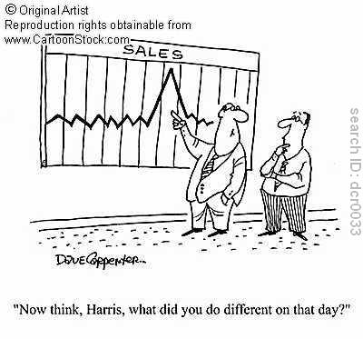
Illustration: Building on Exceptions

Slide 34
Video Example: Parent Consultation (preschool student)
Deborah (parent) concerned about daughter’s “tantrums” at mealtimes
Client Information: Deborah (parent), who lives in a homeless shelter, is very concerned about her daughter Shyla’s behavior during meals (throws her plate of food; screams and cries during meals). Shyla is 4 years old.
Video 1: Dr. Murphy explains the technique of building on exceptions.
Video 2: Dr. Murphy explores exceptions to the meal time problem by asking what is different about the times when Shelia does better during meal time.

Slide 35
Build on Exceptions: Parent Consultation—Explaining the Technique

Slide 36
Build on Exceptions: Parent Consultation—Searching for Exceptions

Slide 37
Practice Exercise:
Building on Exceptions with Carlos (age 16)
(Individually or in small groups)
Student Information: Carlos, age 16, struggling with depression; Desired future includes going to bed by midnight and waking up by 7:00am on school days, eating breakfast in morning, and calling friends more often.
Exercise Instructions: As an individual or small group, think about and list how you would go about identifying, exploring, and expanding an “exception” with Carlos.

Slide 38
Self-Modeling (“Video Exceptions”)
• Determine desired behavior(s) to be increased
• Videotape the student engaging in desired behavior(s) (prompted or unprompted)
• Edit to create a short Greatest Hits video (1 to 3 minutes) showing examples of the student displaying the desired behavior in a few different situations
• Have student view tape every other school day (5 or 6 times) over a two-week period
*Applicable to ANY observable behavior (use phone, camcorder, …)

Slide 39
“Video Exceptions” (Self-Modeling): Aaron, age 10 Diagnosis: Down’s Syndrome with autistic features Reason for Referral: Increased social withdrawal, noncompliance

Slide 40
WSASP Webinar 1 Homework (Skill/Technique: Building Collaborative, Culturally Responsive Relationships)
Homework tasks help you learn and apply webinar content and techniques with yourself, students, caregivers (teachers, parents, others), or role-played clients. Complete the following tasks over the next 3 weeks:
Task #1 (Students/Clients): Implement one or more of the techniques we covered for building collaborative, culturally responsive relationships with students, teachers, parents, or others with whom you work (or with a role-played client/consultee).
Task #2 (Now What?): On a scale of 0 to 10, where 0 is “not very likely” and 10 is “very likely,” how likely are you to use the technique(s) in your current or future work? If you answered 4 or less, what would improve the likelihood of using the technique(s)?

Slide 41
WSASP Webinar 1 Homework (Skill/Technique: Obtaining a Detailed Description of the Desired Future)
Homework tasks help you learn and apply webinar content and techniques with yourself and those you serve (or role-played clients). Complete the following tasks over the next 3 weeks:
Task #1 (Self): Pick an issue or area in your life that you would like to change or improve, then ask yourself the following questions to obtain a detailed description of your desired future and “next steps” toward your desired future in this area.
What are your best hopes for the future in this area of life? If you woke up tomorrow and your best hopes were achieved, what would that look like? What will you be doing differently? Who will notice? What small action will you take this week to move a little closer to your desired future?
Task #2 (Students/Clients): Complete the above task and questions with a student (or a role-played client).
Task #3 (Now What?): On a scale of 0 to 10, where 0 is “not very likely” and 10 is “very likely,” how likely are you to use this technique in your current or future work? If you answered 4 or less, what would improve the likelihood of using it?

Slide 42
WSASP Webinar 1 Homework (Building on Exceptions)
Complete the following tasks over the next 3 weeks:
Task #1 (Self): Pick a problem or concern in your life, then ask yourself the following questions to elicit, explore, and expand on exceptions to the problem.
Elicit: Think of a recent time when the problem could have happened but did not happen, or a time when it was less noticeable than usual.
Explore: What was different about that time? How did you approach things differently to make it happen? What else was different?
Expand: Based on the information above, what can you do to next week to increase the frequency of exceptions to the problem?
Task #2 (Students/Clients): Complete the above task and questions with one of your students or clients (or a role-played client).
Task #3 (Now What?): On a scale of 0 to 10, where 0 is “not very likely” and 10 is “very likely,” how likely are you to use this technique in your current or future work? If you answered 4 or less, what would improve the likelihood of using it?

Slide 43
Q & A

Slide 44
This workshop is only as good as its future application. Take a minute to think about
one or two techniques from our session that you
want to try out during your next week of work…
and JUST DO IT!
THANK YOU. JM
Email: jmurphy@uca.edu Website: www.drjohnmurphy.com

Slide 45
Core Strategies of Brief Solution-Focused Counseling in Schools: A Toolbox of Practical Techniques
John J. Murphy, Ph.D.
Translating Research into Practice
University of Central Arkansas (USA)
E: jmurphy@uca.edu Web: www.drjohnmurphy.com
Participants will learn practical skills and strategies to help them:
1. Build collaborative, culturally responsive alliances with students and others.
2. Shift from problem talk to solution talk.
3. Develop practical goals that matter to students.
4. Identify and build on exceptions to the problem.
Washington State Association of School Psychologists (WSASP)
January 27th, 2017: 9am-12pm PST

