Slide 1
When the Minority is the Majority: Perspectives from and Issues Arising in School
Districts that are not Predominately White
Norm Dorpat, M.S.
Fourth Direction Educational Services
FourthDirectionServices@gmail.com

Slide 2
Presentation Objectives
Participants will:
Receive information regarding language based issues that may affect Native American students that receive School Psychology services
Review a case study of a culturally based program that provides assistance to students experiencing those challenges (NAM Cradleboard to Career project)
Participate in a follow-up Q & A session.
Notes:
.

Slide 3
Perspectives and Hopes...
37 years as a psychologist, teacher, sped. director
Public and tribal school background, P-12
Founding Education Director Northwest Indian College at Puyallup Tribe
Lessons learned in Indian country can apply to Native (and other) learners elsewhere: (note new “Time Immemorial” requirement).
Language and cultural differences can be profound but may also be “hiding in plain sight”. A closer look can inform our profession.

Slide 4
Agenda / Discussion Topics
Historical and present day issues re: school psychology
Culture and Language
Prereferral / referral process, exclusionary factors
The assessment process and eligibility determinations (including possible confounding variables)
Specially designed Instruction and related services
(Think time – questions embedded throughout)

Slide 5
Agenda / Discussion Topics
1) Issues Relating to School Psychology Services for Native American students

Slide 6
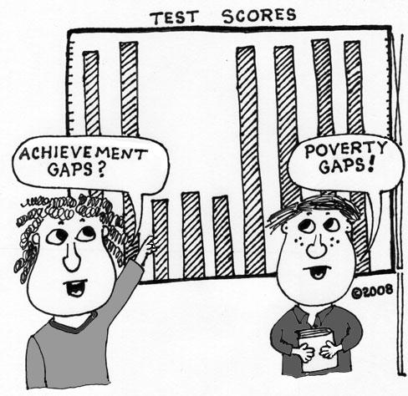
Some of the Boarding School Legacy in Washington State:
Physical removal and cultural disconnection
Intergenerational trauma
Institutional distrust
Longitudinal risk factors
Low achievement
High ACES scores

Slide 7
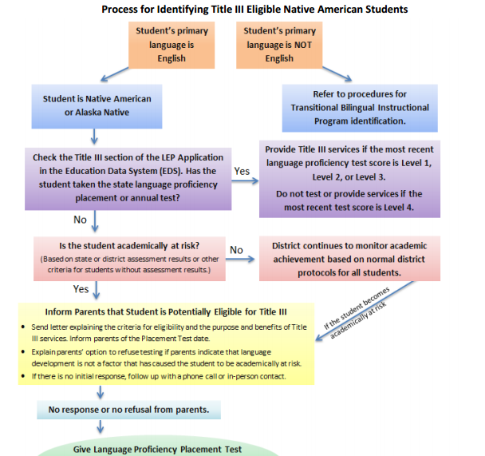
http://www.k12.wa.us/MigrantBilingual/pubdocs/TBIPGuidelinesNativeAmerican.pdf

Slide 8
How does that legacy affect our P-12 learners in relation to school psychology roles?
Risk & protective factor research, e.g., Hawkins/Catalano/Miller (1992)
Trauma informed schooling
Formative vs Summative (including pre-referral and RTI) regarding eligibility for services
  Sped Over representation
  L.D. Overrepresentation
  Developmental Delay category
“False Positives” and “False Negatives”

Slide 9
Achievement Gap fast facts (WSU Clearinghouse)
Native Americans scored significantly lower across all subjects (reading, writing, math and science) and across all grades when compared to their European American counterparts.
A factor that contributes to lower scores is the percentage of Native American students enrolled within a school district, thus indicating that there may be unique challenges and stressors facing public schools with higher numbers of Native American students
... the trend of the “achievement gap” may be more of a reflection of a “data gap,” rendering Native American students “invisible” in terms of educational policies and procedures.
Intent: close the achievement gap and maintain Native American cultural integrity while promoting indigenous knowledge, language, values, and practice
(Where the Sun Rises: Addressing the Educational Achievement of Native Americans in Washington State, 2008)

Slide 10
Representation in Special Education
Native children are often underserved and / or over identified (Hibel, Faircloth, & Farkas, 2008) … they do not get the appropriate services that are needed to ensure equitable access to education or are misidentified and placed in special education. In addition, Native students are under identified for gifted and talented programs. (National Council on Disability, 2003).

Slide 11
Representation in Special Education
Developmental delay – Communication Disorder eligibility, CEIS, and RTI issues are complex and have big-time implications for preventing over-representation in LD for Native students through the discrepancy model (waiting to fail).
Many Native kids become proficient in ORF (become fluent) but continue to struggle with vocabulary meaning and therefore comprehension. Oral language development as the foundation is of course key. Academic English demands present a barrier for many.

Slide 12
“Biopsychosocial variables including maternal and child health, socioeconomic status, parental attitudes toward school and toward cultural separation, and children’s English-language skills accounted for 67% of the Native/non-Native difference on the Performance subscale and 57%of the Verbal subscale score difference”.
Beiser, 2000

Slide 13
Representation in Special Education
Particularly for L.D. eligibility, discrepancy model is suspect for our Native kiddos in some instances. Therefore, formative data in an RTI context is key both for entry and exit into sped. That begs the question of progress monitoring. Student response to sufficient high quality RTI / ELL services is therefore of increased importance.
System building for that in the context of language / developmental issues a key issue, particularly in the preschool and primary years.

Slide 14
Beyond Eligibility – the Ongoing Role of a School Psychologist: Promote Psychological Well-Being
Promote positive sense of self
Reduce Risk Factors, Increase Protective factors: attachment
Well Being: absence of alcohol and substance abuse, depression, suicidality, juvenile delinquency and maladaptive attachment and adjustment patterns
  Suicide rates highest of any ethnicity
  QPR or related method established in your district?

Slide 15
Agenda / Discussion Topics
2) Culture
and
Language

Slide 16

“Capable, Connected and Contributing”
Strong family and cultural connections build language capability.
(Heritage) Language helps students re-connect and contribute.

Slide 17
Assessment of Proficiency in L1 and L2 among Native Americans must be considered within the context of the community and status of the language itself

Slide 18
Culture is language, language is culture
Elder status
Religious Beliefs
Employment
Societal norms
Social roles
Media usage
Social relations
Gender roles

Slide 19
Standard Methods for Evaluating Acculturation
Ethnographic Interview
Contextual Observation
Questionnaire / Survey
Formal Assessments

Slide 20
The Term ELL may not be a good fit for many Native learners
1) Carries negative connotations for many. May be mistakenly equated to “dual-language”
2) Many Native (Title III eligible) students with language differences may not speak their heritage language but may be equated in education to “Bi-Lingual”
3) Language revitalization is a high priority for many tribes, however many tribal languages are no longer spoken or had been in decline.

Slide 21
Interpersonal vs Academic English
Basic Interpersonal Communication Skills:
  Social, colloquial and idiomatic
  Can be complex and nuanced
Cognitive Academic Language Proficiency (CALP)
  Language skills needed to do schoolwork
  Critical to academic progress
  Takes English Learners up to 7 years to acquire (Collier, 1989)

Slide 22
Question
What might a School Psychologist consider when asking a Native student (or parent) to tell you their language preference and then determining assessment practices or services based on that response?
  For dual-language ELL Indian student?
  For English “deficient” ELL Indian student?

Slide 23
Beyond Interview/Observation to formal Language Assessments
Possible Issues:
“N” size proportional in normative sample?
Very few in Native languages. Translation issues?
Different tests give different weights to components of language
Few tests measure higher academic concepts
Not all tests examine receptive and expressive language

Slide 24
Utilize Multiple Meaures to Assess Language Proficiency
Standardized Assessments
Observations
Questionnaires
Teacher Rating Scales (i.e. SOLOM)
Storytelling
Story Retelling
Language Samples
Notes:
(

Slide 25
Thoughts on qualitative L1 language assessment…
Assessment of abilities in Native language often relies on a speaker of that language to conduct qualitative methods, e.g., interview. How can this be effectively accomplished when many Native languages are not yet spoken fluently by school staff?
Tip: Ask the ELL interventionist and/or Native Education specialist to assist. Collaborate with the local tribe!

Slide 26
Agenda / Discussion Topics
3) Prereferral / Referral Process and exclusionary factors
longitudinal MTSS data is essential

Slide 27
Referral Artifacts
If teachers refer a child, chances are they will be evaluated
Referrals are at times made because non-Sped interventions are limited or of poor quality.
Referrals may lack a connection to functional or academic “adverse impact”

Slide 28
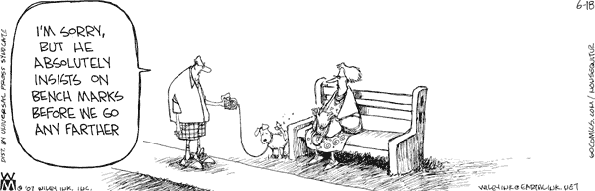
Clear benchmark data helps limit referral bias

Slide 29
Possible issues in prereferral process
Social maladjustment
Behavioral problems
Oral-language related
Reading problems
Learning difficulties
Socio-economic difficulties
Medical Diagnosis
Written language
Low attention span
Unable to understand and/or follow directions
(Ochoa, Robles-Pina, Garcia, & Breunig, 1999)

Slide 30
Possible ELL Behavioral Characteristics (e.g., BASC results that may be only descriptive
Shy
Timid
Anxious
Withdrawn
Disorganized
….Could this be part of a typical acculturation process? (Rhodes, Ochoa, Ortiz, 2005)
…… Or an examiner/examinee cultural disconnect?

Slide 31
WELPA / ELPA21 Assessment as pre-referral data
1) These data are useful in Prereferral process
2) ELA interventionists should help guide the MTSS / IEP process.
3) Engage the Indian Education Specialist or TED as early as possible in the process

Slide 32
http://www.k12.wa.us/MigrantBilingual/pubdocs/TBIPGuidelinesNativeAmerican.pdf

Slide 33
Language assessment in context
WELPA and now ELPA21
Screening Process for Native English development services
  Reliability– sample size
  Validity: complexity of accessing child's knowledge
Primarily a summative assessment at the end of the year. How does that relate to an assessment process earlier in the year that accounts for ELL status?
Relationship to instruction: is the ELL service modeled after a transitional bilingual program? Does that approach meet Indian child needs?

Slide 34
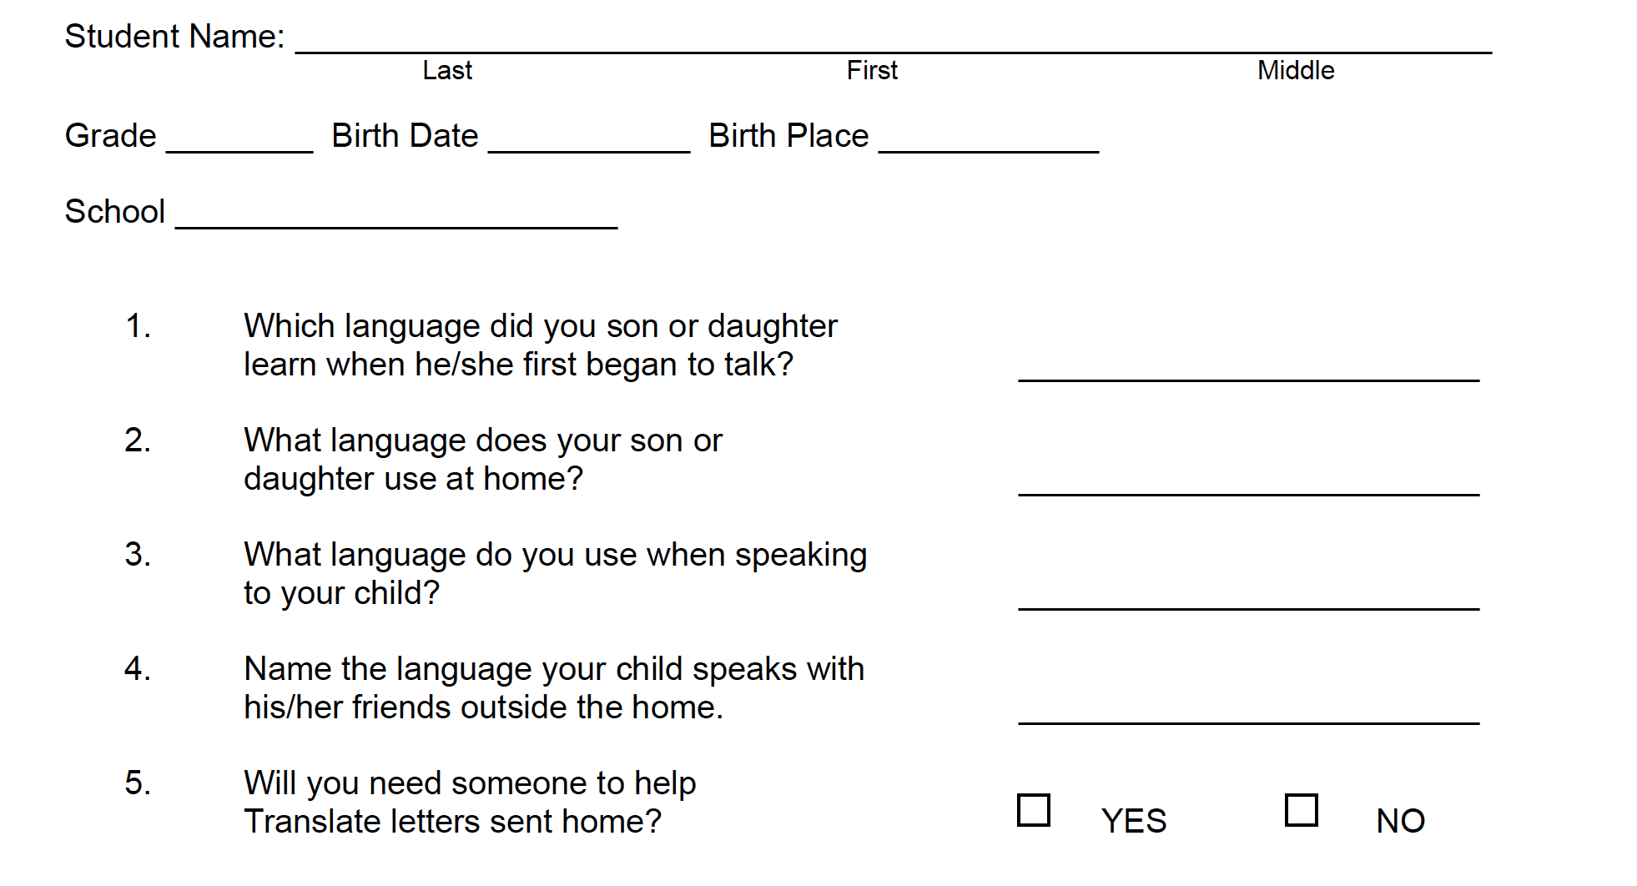
Home Language Survey is the “gateway” to English Language Development Services. Does survey detect language differences that go beyond Dual Language?
Placement Test is used to determine initial student eligibility for E.D. services (The Placement Test is given to all students whose families answer “a language other than English” to question #2 or to question #3 on the Home Language Survey.) Note: The ELPA21 screener is currently under development and will be operational for the 2016-17 SY.

Slide 35
http://www.k12.wa.us/MigrantBilingual/pubdocs/TBIPGuidelinesNativeAmerican.pdf

Slide 36
Title III / ELL / Transitional Bilingual Issues
Native Americans comprise a unique population in regards to Title III eligibility. Native Americans do not have to be dual-language to be identified as ELL. The definition recognizes that language differences (particularly for Academic English) have a significant impact in both the administration of Educational Assessments and interpretation of results.
However, many Native students do have some proficiency in their heritage language. While a Spanish version of a WISC can be administered to a dual-language student, no equivalent option exists for a Native American students.

Slide 37
Native Title III Status as RTI
Are RTI results, if any, sufficient to indicate “at risk” status for N.A. Title III testing and possible Language Development services? Are those services of insufficient time, intensity and duration to inform the SpEd assessment process?
If not, how can the MDT determine if ELL is a confounding variable in determining if there is a disability?

Slide 38
“By the Book” OSPI Native Title III eligibility. What factors determine if a student is “at risk”?
The PRESENT and historical reality: An active and extended outreach effort to engage the parents as partners is often essential given the history of inter-generational trauma (see ACES research) and active language / cultural suppression by federal (boarding school legacy) and state (fishing wars) policy. How build trust and engagement?
Title VII Indian Ed programs are stretched thin.
Parental engagement results from a community approach (six hours is not enough)
Trust is built over time and patience and personal contact. Be present and active in the community!

Slide 39
“By the Book” OSPI Native Title III eligibility. What factors determine if a student is “at risk”?
A Native student may present as not “at risk” given written English tasks (state assessment results), but struggle with oral language, particularly as an older child exposed to demanding Academic English tasks.
For example, word meaning and background knowledge may be limited, despite scoring well on Oral Reading Fluency.

Slide 40
Native Title III eligibility, continued
In the absence of state and district assessment results: consider multiple indicators, such as classroom-based assessments, curriculum-based assessments, or teacher recommendations. For students newly entering the school system, allow sufficient time for adjustment and instruction to occur before making the determination that the student is academically at risk.
Pre-referral / RTI efforts must be of high quality and high fidelity to accomplish the above with many Native students who may “fly under the radar”. This may yield “false negatives”.
Active interventions during the “adjustment period” must be active and not just a matter of “sufficient time”. Formative, not just summative, data is critical

Slide 41
Native Title III eligibility, continued
Tautological issue?
Asterisk (from OSPI eligibility flowchart): “….refer to the IEP/504 team to make determination whether “LEP due to conditions beyond language proficiency” (exclusionary clause).
How is above condition reasonably accomplished if response to ELL services is needed to inform a proper referral for a Special Education eligibility assessment?

Slide 42
Language Assessment Accommodations?
Allowable accommodations can be provided to English language learners with a disability on the WELPA only if the student’s disability is documented in an IEP or 504 plan, which should describe the student’s need for that accommodation.
Accommodations for English language learners are intended to mitigate the effects of limited language proficiency in order to provide students the opportunity to demonstrate knowledge and skills on state assessments and should be documented.
Decisions about the assignment of accommodations for English language learners should be made by a team of instructional staff.

Slide 43
From OSPI “Process for Identifying (dual and non-dual language) Title III Native American students:
*if the student has a disability (suspected?), refer to the IEP/504 team to make determination whether “LEP due to conditions beyond linguistic parameters”

Slide 44
Agenda / Discussion Topics
4) The assessment process and eligibility determinations (including possible confounding variables)

Slide 45
Formal Referral and Assessment process for Native Students
Issues surrounding the over identification have been reported to be linked to assessment practices (Banks & Neisworth, 1995) and teacher referral (and therefore assesment) practices which fail to account for cultural and linguistic diversity of Native students (Banks, 1997; Demmert, 2005).

Slide 46
Language Proficiency Scores
1) Should be part of eligibility assessments, IEP goal setting and services
2) Should be intentionally utilized in special education assessment processes
3) Parents must be engaged so that they can understand and contribute in the context and culture of the Native community and language(s).

Slide 47
Limitations of the evaluation as a result of cultural and linguistic factors:
  Evaluation data for English Learners may underestimate students’ abilities and should be interpreted with caution because test norms may not reflect the cultural and linguistic backgrounds of ELLs.
  A review of normative data shows that in some cases no Native Americans were included in the normative samples.

Slide 48
Lack of Native L1 versions of assessments used in eligibility assessments:
When evaluators use bilingual assessment, tests were administered, in whole or part, in Spanish and English by using the Spanish version of a test (e.g., Wechsler Intelligence Scale for Children, Fourth Edition-Spanish).
No such test exists for heritage languages of tribes in Washington State, e.g., Salish languages.

Slide 49
ELL as exclusionary cause?
WELPA accommodations are available only to SWD
Eligibility for “ELL services” is based on a low WELPA score on the placement test
A Native student who scores as ELL may not be identified as learning disabled due to language (and “socioeconomic status”) as exclusionary factors
Student becomes a “false negative”

Slide 50
Assessment of Learning (WSU Clearinghouse) https://education.wsu.edu/documents/2015/08/native-american-achievement-gap-executive-summary.pdf
School Psychology and “overrepresentation "From WSU report:
“Traditionally, neither teacher nor school psychology training programs have paid attention to Indian education, resulting in the perpetuation of overrepresentation of Native students in special education and their underrepresentation in gifted and talented programs.
School psychologists are responsible for the bulk of the diagnostic testing that contributes to misidentification of Native students. Therefore, cultural competencies in Indian education must be addressed in preparation programs responsible for training teachers and school psychologists.”
  Think Time: Does this statement reflect your training program? What implications for assessment process?

Slide 51
Assessment of Learning (WSU Clearinghouse) https://education.wsu.edu/documents/2015/08/native-american-achievement-gap-executive-summary.pdf
Two recommendations speak directly to the assessment process:
Shift the Paradigm through Relationship Building
  develop relationships between public school districts and tribes as well as help urban Indian education programs to integrate Native teaching and learning that benefits Native and non-Native children.
    Reach out to local and state tribal representatives to seek input on best practices in identifying and serving Native students with disabilities (TEDs, Native Higher Ed, OSPI ONE office, etc.,)
Improve authenticity of data and reporting:
  data pertaining to Native students can be used by program personnel close at hand to guide daily decisions.
    Is there a focus in our profession on summative assessments? If so, does that method adequately contextualize eligibility assessments?

Slide 52
Guiding Questions in assessment practices
Demmert (2005) describes “a disturbing analysis of the academic performance level of Native American (students) in comparison to the majority of middle-class white students” (he also cites limited data):
1) “How accurately do the instruments used for assessing academic performance reflect the true knowledge base of the Native American student”?
2) “Are there extenuating circumstances that must be taken into account when using standardized assessment tools that may have been developed for a select group of students”?

Slide 53
Assessment tools
Adequacy of Culture Free and Culture Fair tests? Comprehensiveness?
review of the normative statistics for a recently administered test (not an isolated instance) suggests a concern with the standardization process. The test’s validation manual indicates that most of the testing sites used in the standardization process were well removed from Indian country. Native Americans were the only census ethnicity/race not specifically cited in the normative sample.
Low or no N.A. inclusion is not uncommon.

Slide 54
Native American Disproportionality
Assessment issues can lead to higher rates of “disproportionality” in Special Education programs serving Native Americans. Even on “reservation (tribal) schools” disproportionality is an issue. Students in BIE tribal schools are identified as eligible for Special Education at a rate approximately 8% higher than in public schools. Rates of identification of English Language Learners within federally funded tribal schools (“LEP”) are over twice the rate than the overall rate in public schools (National Center for Education Statistics, 2013); (Bureau of Indian Education Summary School Report Card, 2013).

Slide 55
Bussing into the Comprehensive School setting
To what extent are services provided in partnership with parents (community context)?
Equitable services for Native and nonNative children with disabilities and their families remain elusive (National Council on Disability report on the status of people with disabilities on tribal lands, 2003).

Slide 56
Embedded in the IDEA mandates are provisions for assessments and IEPs are to be developed in collaboration with families (and therefore communities).
School Psychologists are in a position to guide the process of data collection and analyses of goals identified in the IEP and ensure accountability for service provision program evaluation, and procedural safeguards for students and their families.

Slide 57
Agenda / Discussion Topics
6) Specially Designed Instruction and Related Services

Slide 58
ACES
“I have yet to receive a letter from a child somehow debilitated by the domestic violence, drug abuse, racism, poverty, sexuality, and murder contained in my book. To the contrary, kids as young as ten have sent me autobiographical letters written in crayon, complete with drawings inspired by my book, that are just as dark, terrifying, and redemptive as anything I’ve ever read”
(regarding “The Absolutely True Diary of a Part Time Indian” Sherman Alexie (2011))
http://blogs.wsj.com/speakeasy/2011/06/09/why-the-best-kids-books-are-written-in-blood/

Slide 59
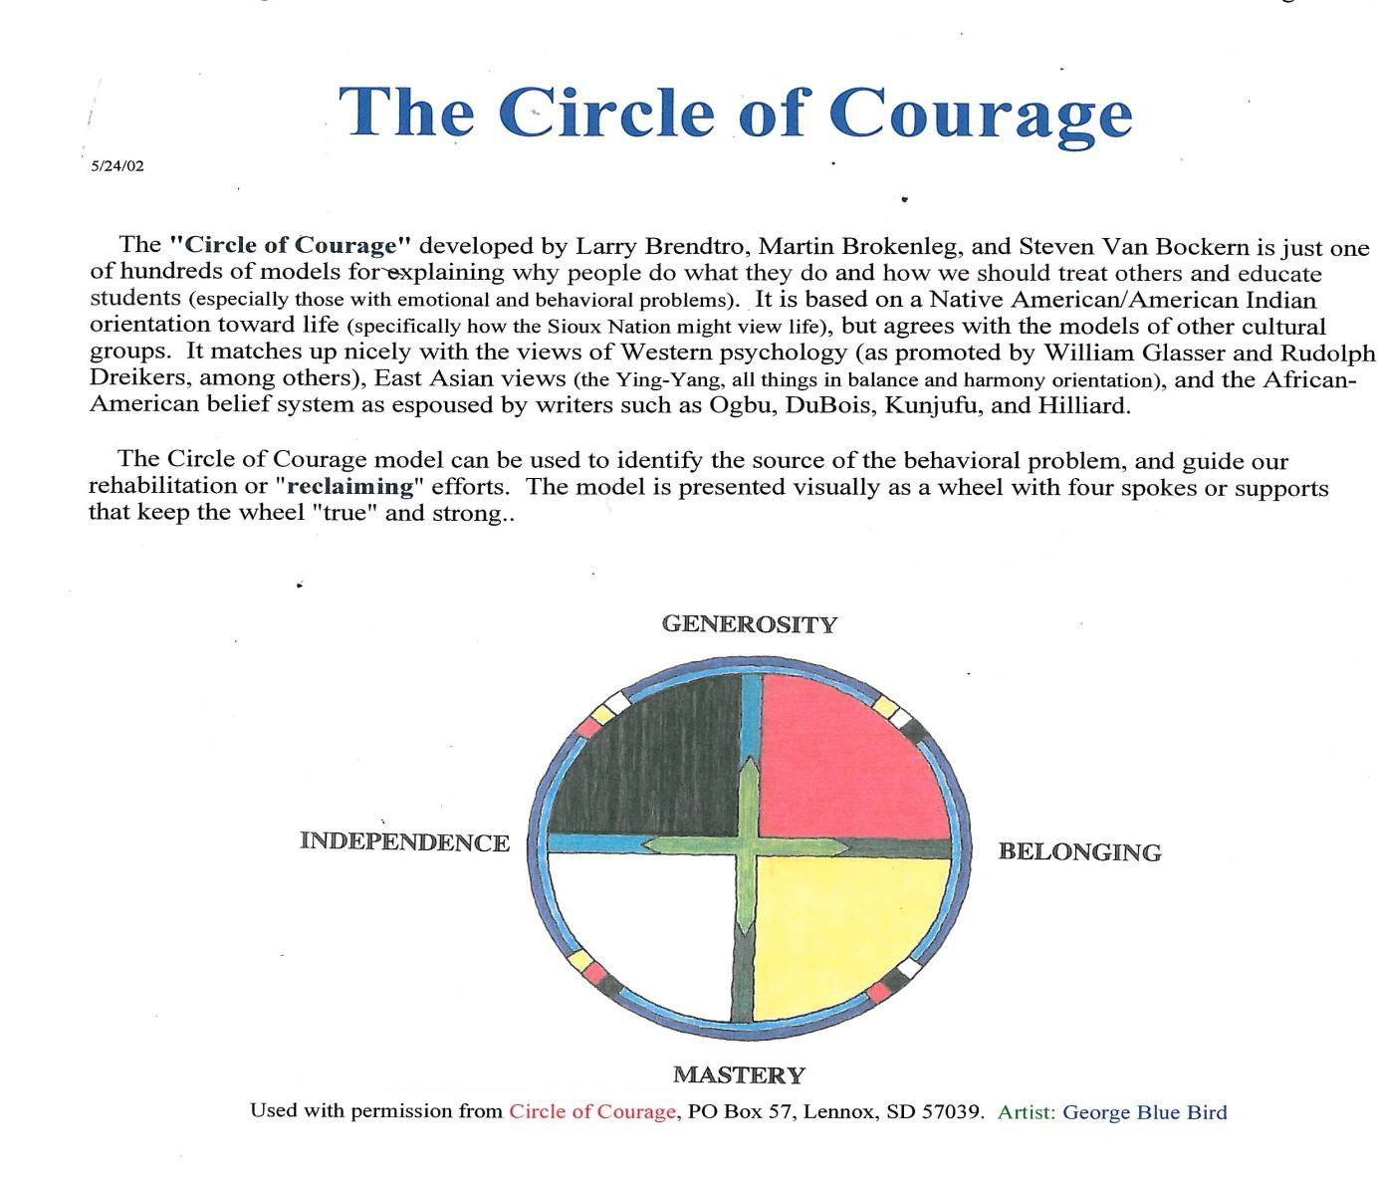

Slide 60
Role and Function of a School Psychologist in Indian Country
Build a relationship first (let it come to you)
  Understand that child's characteristics in the context of community
  Build trust over time. Engage in the welcoming community
  The extended family, e.g., Canoe family – the prosocial positive context of language and culture together.

Slide 61
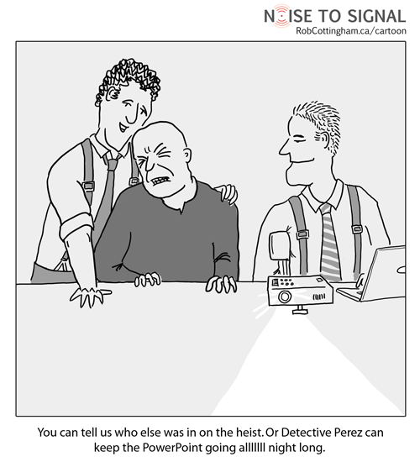
Briefly: “Cradleboard to Career”, an example of supplemental program providing N.A. language development (NAM grant)

Slide 62
Community based “adapted sheltered language” language development and intervention
Response To Intervention (RTI): Include explicit instruction in oral and written language “5 components” (includes both English and Twulshootseed, e.g., phonemic development).
Direct
Applied
Relevant
Strengths Based: Intentionally build on students’ prior knowledge and interests. Support cultural content and family connections including Twulshootseed instruction
Contextual: Provide frequent guided practice prior to public performance. Include authentic opportunities for engagement including “after school”.

Slide 63
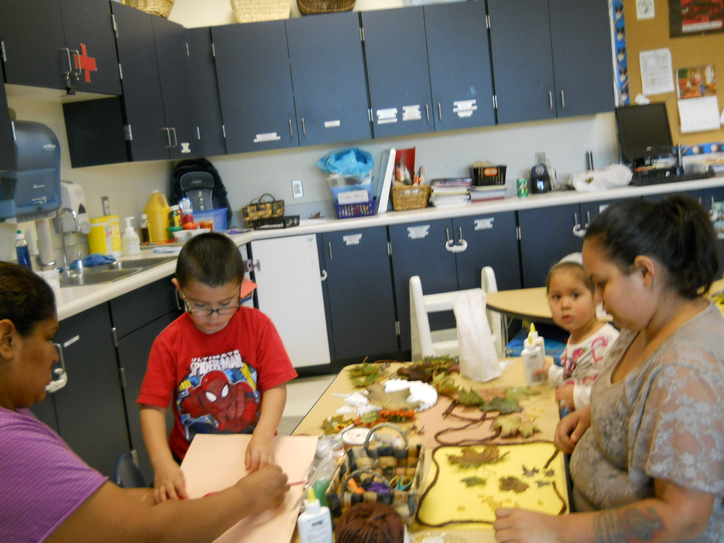
  1) “Parents as Teachers” (extended model)
  2) “Readiness to Learn” (family supports)
  3) Grades K-5 language (language intervention with 5 year cohort follow-through)
Three program components; all include family connections and “community school” leveraging of resources.

Slide 64
Explicitly taught story telling as part of "oral tradition”… (excerpt from parent newsletter)
“We (modeled the) importance of voice ‘intonation’ and having variety and expression in one’s story telling….The kids really seemed to enjoy the stories, and their laughter and comments let us know that our goal had been attained!”

Slide 65

http://www.puyalluptriballanguage.org/learning_opportunities/traditional_ways/traditional_ways.html

Slide 66

Cross age tutoring and materials development by siblings, cousins, and older students: Service Learning “Warrior Hours”

Slide 67
Many tribes have heritage language resources including downloads and websites
Example: Twulshootseed mobile Apps (itunes download and Puyallup-tribe.com):
Twulshootseed Alphabet
“75 Words” Vocabulary development App
Texting Twulshootseed
Twulshootseed: “What Is That”

Slide 68
Who May Apply for a NAM grant (elementary, secondary and post-secondary schools):
Indian tribes and tribally sanctioned educational authorities
Native Hawaiian or Native American Pacific Islander native language educational organizations
Elementary schools or secondary schools that are operated or funded by the Bureau of Indian Education (BIE), or a consortium of such schools
Elementary schools or secondary schools (funded by) the BIE in consortium with another such school or a tribal or community organization
Elementary or secondary schools operated by the BIE and an institution of higher education (IHE), in consortium with elementary schools or secondary schools (funded by) the BIE or a tribal or community organization
Refer to the following source for specific current information: http://www2.ed.gov/programs/naancs/eligibility.html

Slide 69
Native American and Alaska Natives In School Program (NAM) funding:
(Average of approximately $275,000 per award per year)
Of the 12 applications recommended for funding,
11 addressed Competitive Priority -Increasing Postsecondary Success
12 applications addressed Competitive Priority -Enabling More Data-based Decision-Making.
In addition, 12 addressed Invitational Priority -Supporting Native American Language Instruction
National Center for English Language Acquisition (including NAM): http://www.ncela.us/native-american-and-alaska-native-children-school-program
http://www2.ed.gov/programs/naancs/eligibility.html

Slide 70
Web Links:
http://www.goia.wa.gov/faq/faq.htm
NAM Grant Authorizing Statute (Title III, Part A, Subpart 1, Sec. 3112, 20 U.S.C. 6822-Native American and Alaska Native Children in School Program)
Native American and Alaska Native Children in School Program http://www2.ed.gov/programs/naancs/index.html
(see FAQ, eligibility, awards, etc.)
http://www.ncela.us
http://www.bie.edu
http://k12.wa.us/indianed/
http://www.aihc-wa.com/

Slide 71
Thank you!
Norm Dorpat, FourthDirectionServices@gmail.com
www.grantfundsnow.wordpress.com

Slide 72
References:
COMMUNITY DEVELOPMENT AS CONTEXT FOR ALCOHOL POLICY NORMAN DORPAT, M.S. 2002
American Indian and Alaska Native Mental Health Research The Journal of the National Center Volume 4, Number 3, 1992 Published by the University Press of Colorado

