Slide 1


Cognitive Profile Analysis in School Psychology: Caveat Emptor
Ryan J. McGill
William & Mary
2020 Washington State Association of School Psychologists Spring Lecture Series, Cheney, WA

Slide 2
About Me
Training background.
Practice background.
Theoretical orientation.
Current research and training foci.
COI disclosure.

Slide 3
Overview and Goals
Discuss historical roots of old and current profile analysis methods.
Core assumptions of profile analytic methods.
Potential psychometric and conceptual issues.
Current status of profile analysis in school psychology training and practice.
Potential implications for practice.
Q&A.

Slide 4
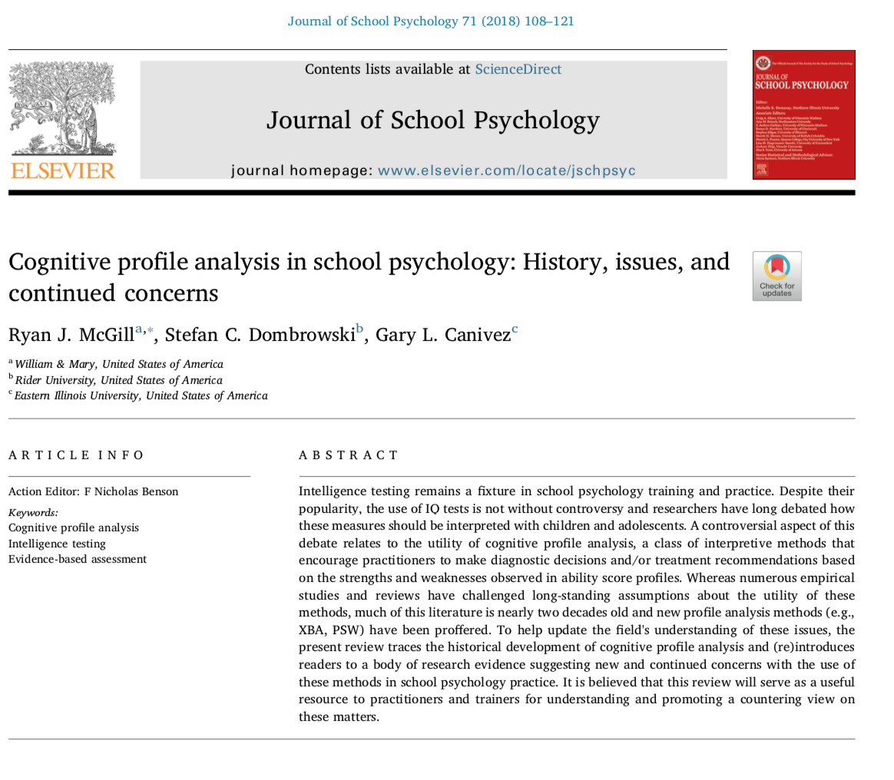

Slide 5
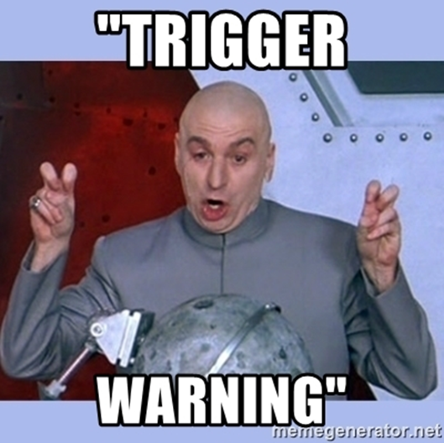
Some Caveats…
These are value laden issues.
Stipulate:
  Profile analysis has long made intuitive sense.
  We were all taught to do this stuff too.

Slide 6
Black Box Warning
“cognitive profile analysis in all of its forms has long been implicated as psychometrically flawed (Canivez, 2013; Kranzler et al., 2016, Macmann & Barnett, 1997; McDermott et al., 1990, 1992; Watkins, 2000) and the ecological/treatment utility of the strengths and weaknesses generated from these analyses has historically been poor (Burns et al., 2016; Elliott & Resing, 2015; Fletcher & Miciak, 2016). As a result, the scores associated with these analyses and the methodologies where employed should be interpreted with caution.”

Slide 7
Guiding Principle 1: Sources of Evidence
Test publishers’ catalogs
Test manuals, Workshops
Mental Measurements Yearbook
Professional Newsletters
Peer-referred studies/Journals
  Gold standard but not above reproach
  Journal quality
  Type of article (empirical study vs lit review)
Publisher manuals/continuing ed.
  Conflicts of interest.
White papers and other technical literature
Informal sources

Slide 8
Evidentiary sources are not equal.
  Sometimes they should not even be regarded as evidence.
Things to consider:
  Quality of the source.
  Empirical versus non-empirical.
  Peer reviewed.
  Are claims supported.
  Potential conflicts of interest.
Imperative to consider quality of sources when evaluating the evidence base for a claim.

Slide 9
Guiding Principle 2: Measurement Matters
Reliability (Consistency in scores/measurement).
Validity (Appropriateness of inferences based on test scores).
Diagnostic Utility (Individual applications: prediction for the individual, diagnostic utility, classification of individuals).
Treatment Validity (Link between a test score or score comparison that reliably indicates some specific treatment or differential application produces differential improvement.
Procedures used for diagnostic decision-making in school psychology must be supported with appropriate scientific evidence above and beyond a subjective belief that such procedures are valid (Lilienfeld, Ammirati, & David, 2012).

Slide 10
Guiding Principle 3: Ethics Matter
All test scores and test score comparisons used in making decisions about children require psychometric support of their reliability, validity, diagnostic utility, and at times, treatment validity
The use of test scores in clinical practice is guided by professional ethics.
All professional associations have ethics codes to guide professional conduct and have ethical standards or guidelines that indirectly and directly impact test score interpretation.
Effective clinicians “(a) know what their tests can do and (b) act accordingly. Knowing what one’s test can do—that is, what psychological functions they describe accurately, what diagnostic conclusions can be inferred from them with what degree of certainty, and what kinds of behavior they can be expected to predict—is the measure of a psychodiagnostician’s competence. Acting accordingly—that is, expressing only opinions that are consonant with the current status of validity data—is the measure of his or her ethicality.” Irving B. Weiner (1989, p. 829)
Weiner, I. B. (1989). On competence and ethicality in psychodiagnostic assessment. Journal of Personality Assessment, 53, 827-831.

Slide 11
Professional Standards
Other professional associations such as the International Test Commission (ITC), American Psychological Associations (APA), American Educational Research Association (AERA), and the National Council on Measurement in Education (NCME), as well as others, are also concerned with proper use of psychological tests and there are specific guidelines that address important responsibilities of both test users and test publishers (AERA, APA, NCME, 2014; ITC, 2010).
Standards for Educational and Psychological Testing (AERA, APA, NCME, 2014)
ITC International Guidelines for Test Use (ITC, 2000)

Slide 12
Profile Analysis 1.0 (1930-1999)

Slide 13
Development and Historical Influences
Clinical influence of the Wechsler Scales.
  Early speculation about pathognomonic meaning of subtest profiles.
Abnormal test scatter (Harris & Shakow, 1938).
Diagnostic psychological testing (Rappaport, Gil, & Shaffer, 1946).
  First formal system that could be used across tests.
  Systematic step-by-step level of analysis.
  Visual inspection of scores.
Ipsative assessment (Davis, 1959)
  Deviation of score from reference anchor
  plus = strength, minus = weakness

Slide 14
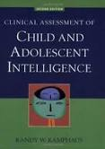
History of Intelligence Test Interpretation (Kamphaus, Winsor, Rowe, & Kim, 2005)
First Wave (1900-1940)
Second Wave (1945-1995)
Third Wave (1997-Present)
Role of Factor Analysis: EFA/CFA
Notes:
First Wave: Most tests composed of only a full-scale score, interpretation limited to where that score fell according to corresponding descriptive criteria.
Second Wave: Development of factor and subtest scores, emphasis on clinical decision making and interpretation (Matarazzo, 1972; Rapaport, Gil, & 1945-1946). Emphasis on linking process or observed profiles with pathology.
Third Wave: Development of theory-based testing and application of advanced psychological techniques to test development. De-emphases on linking test scores to pathology. Intelligent testing interpretation (Kaufman, 1994). Differentiation of third wave is a bit more muddled then the rest.

Slide 15
1.0 Methods
Within Specific Test
Standard Scores/Percentiles/Confidence Intervals (based on internal consistency)
FSIQ/Global Composite Score (Carroll's Stratum 3)
Factor Scores/Broad Ability Scores (Carroll's Stratum 2)
Subtest Scores (Carroll's Stratum 1)
Ipsative Comparisons-Factor Scores (Each Factor Score Compared to Mean)
Pairwise Comparisons-Factor Scores (Each Factor Score Compared to Each Other)
Ipsative Comparison-Subtest Scores (Each Subtest Score Compared to Mean)
Pairwise Comparisons-Subtest Scores (Each Subtest Score Compared to Each Other)
Additional consideration of pseudo composites:
Theoretical/Content Based Composites (Combinations of Subtests [i.e., WISC–V Ancillary Index Scales] not factorially derived.

Slide 16
Intelligent Testing (IT; Kaufman, 1979; 1993)
Step 1: Interpret the global composite.
Step 2: Interpret the index scores.
Step 3: Interpret subtest scores.
Step 4: Evaluate index-level strengths and weaknesses.
Step 5: Evaluate subtest-level strengths and weaknesses.
Steps no longer encouraged:
Scatter analyses.
Item-level analysis.

Slide 17
Impact of IT on Test Interpretation
“A major purpose of intelligence testing was to impose some empirical order on profile interpretation; to make sensible inferences from the data with full awareness of errors of measurement; and to steer the field away from the psychiatric couch” (Kaufman, Raiford, & Coalson, 2016).

Slide 18
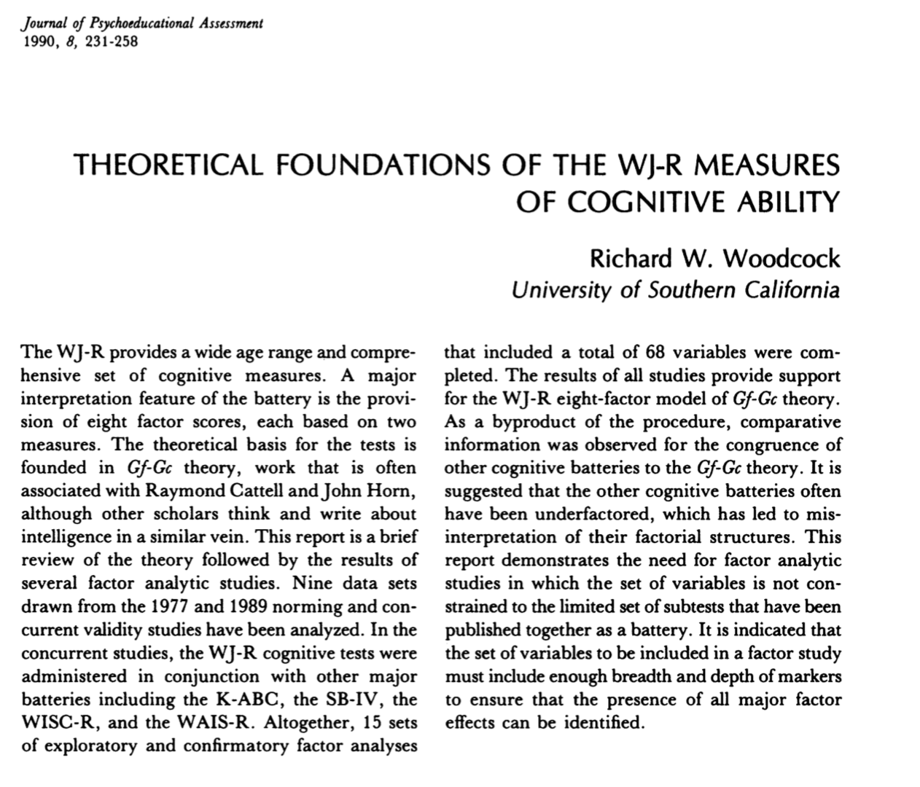
Rise of Multiple Battery Assessment (Woodcock, 1990)

Slide 20
Key Elements of 1.0 Approaches
Encourage subtest-level analysis.
Largely test specific (i.e., Wechsler Scales).
De-emphasize interpretation of FSIQ.
Scatter analyses.
Heavy emphasis on ipsative analyses.
Many of these approaches emerged during a time in which the tools for advanced psychometric analyses were largely underdeveloped.
  Advanced and maintained largely through clinical lore.
Notes:
Robust factor analytic and diagnostic validity studies don’t emerge in the school psychology literature until the mid to late 90s.

Slide 21
Challenges to Historical Approaches

Slide 22
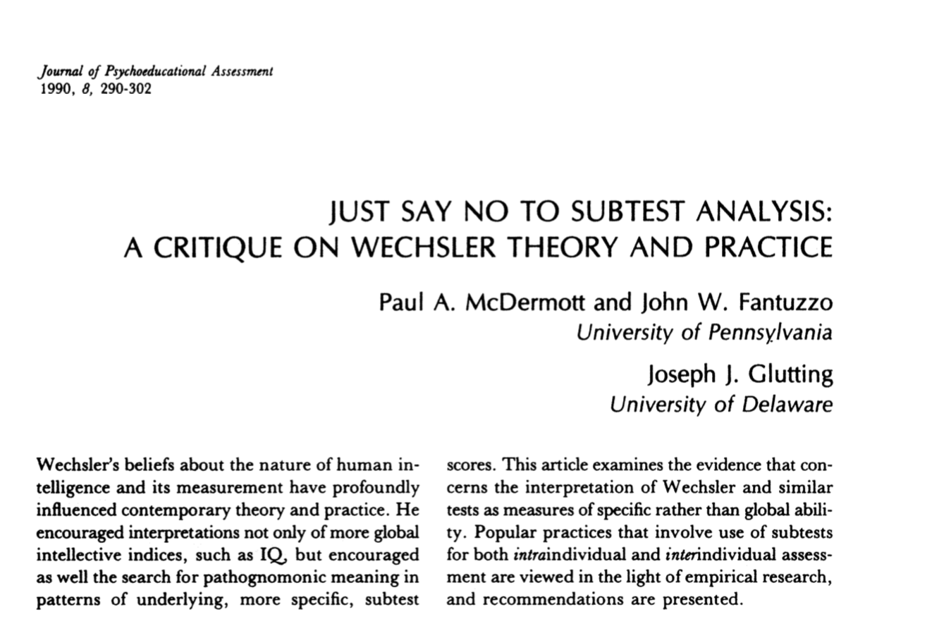
“Just Say No” (McDermott et al., 1990)

Slide 23
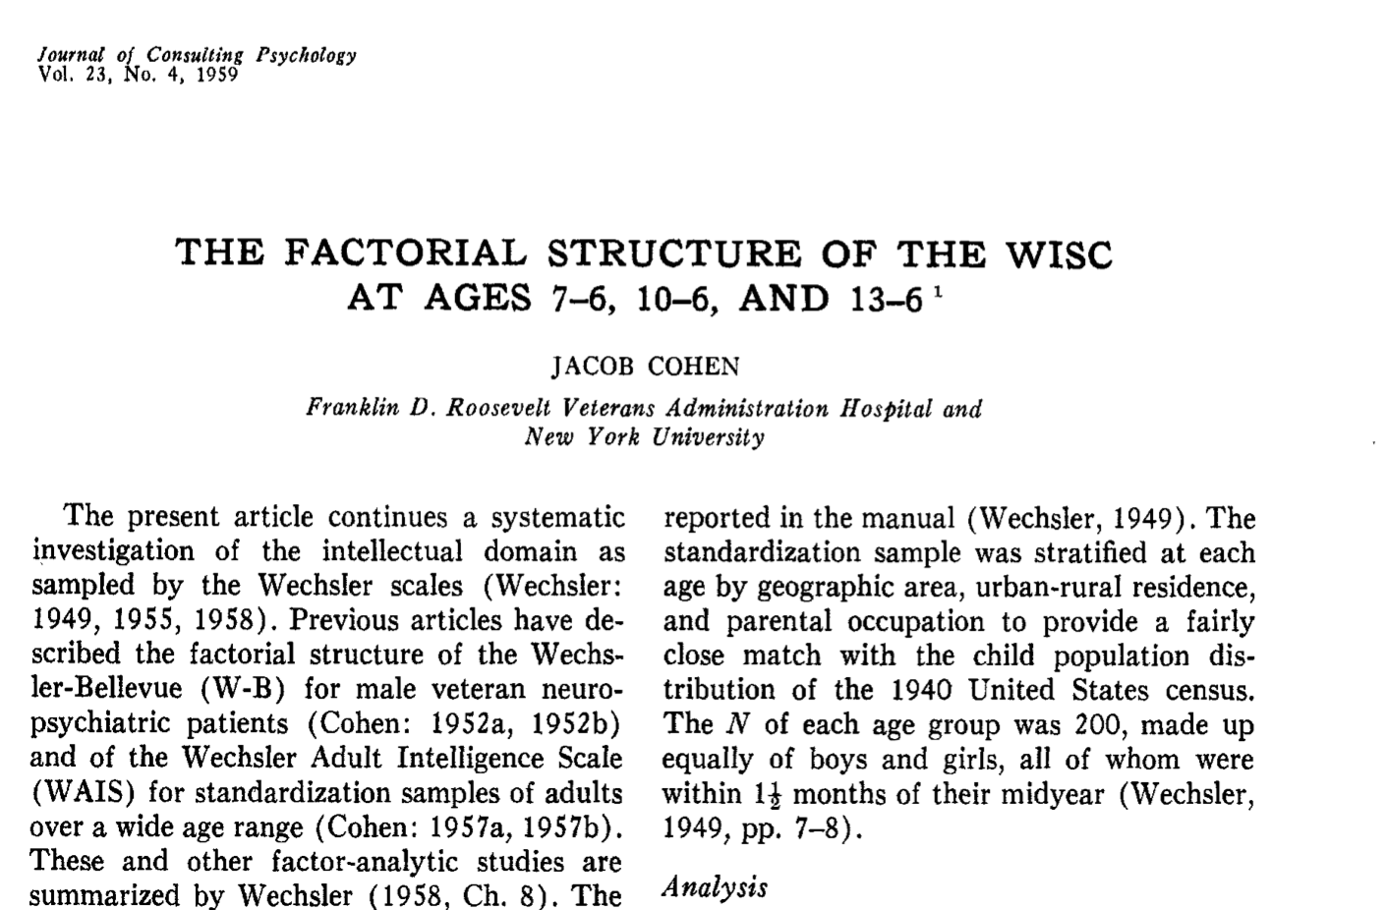
A Prelude of Things to Come… (Cohen, 1959)

Slide 24
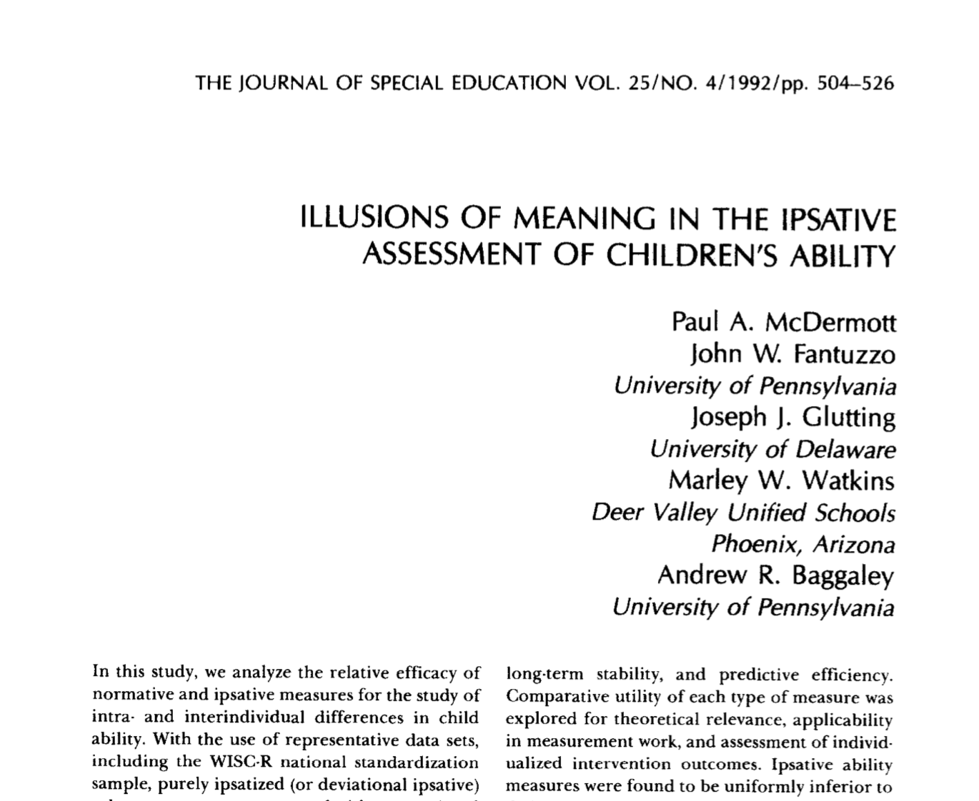
Illusions of Meaning (McDermott et al., 1992)

Slide 25
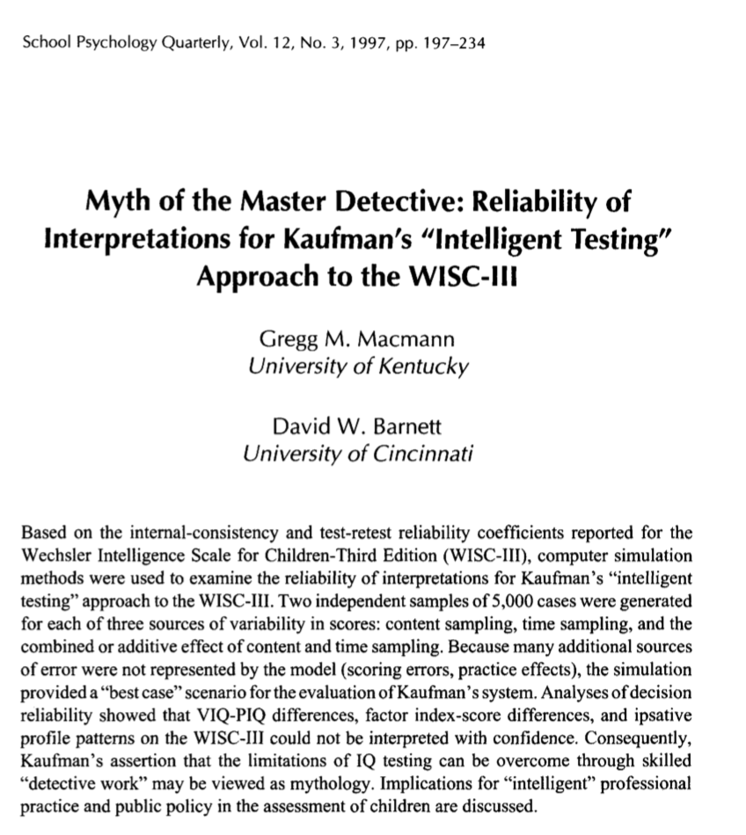
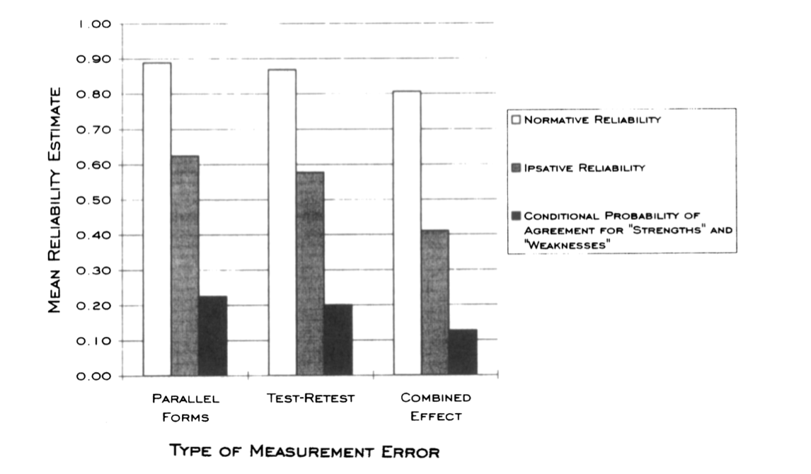
Myth of the Master Detective (Macmann & Barnett, 1997)

Slide 26
“the hypothesis reduces the perception of uncertainty, providing a means through which clinicians can "understand," that is, construct meaning or make sense of an otherwise ambiguous situation. The fact that an altogether different, yet equally "meaningful," interpretation of the evidence might emerge three weeks later is outside the clinician's immediate awareness and thus difficult to comprehend…Therefore, although professional training and experience are likely to increase one's sense of self-confidence and proficiency in the use of the technique, the inferences that result are largely determined by chance” (Macmann & Barnett, 1997, pp. 228-229).

Slide 27
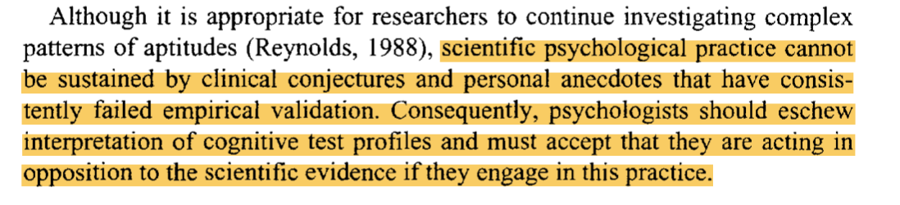
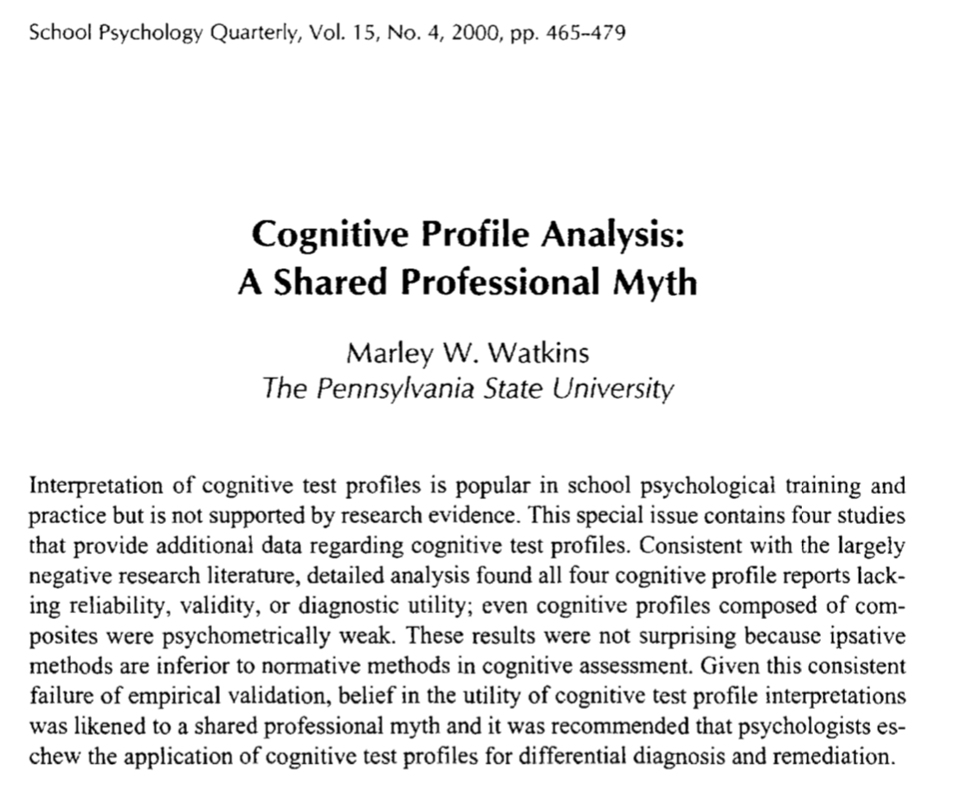
Shared Professional Myth (Watkins, 2000)

Slide 28
Provisional Limitations of XBA (Watkins, Youngstrom, & Glutting, 2002)
Comparability of scores from different tests.
Order effects.
Sampling issues: size and representativeness.
Procedures employed to categorize subtests.
Ipsative interpretation.*
External validity.
Efficiency and economy.
Vulnerability to misuse.

Slide 29
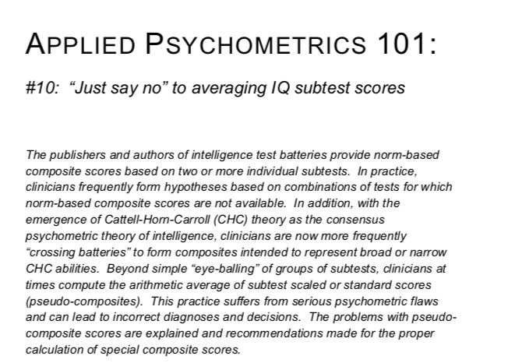
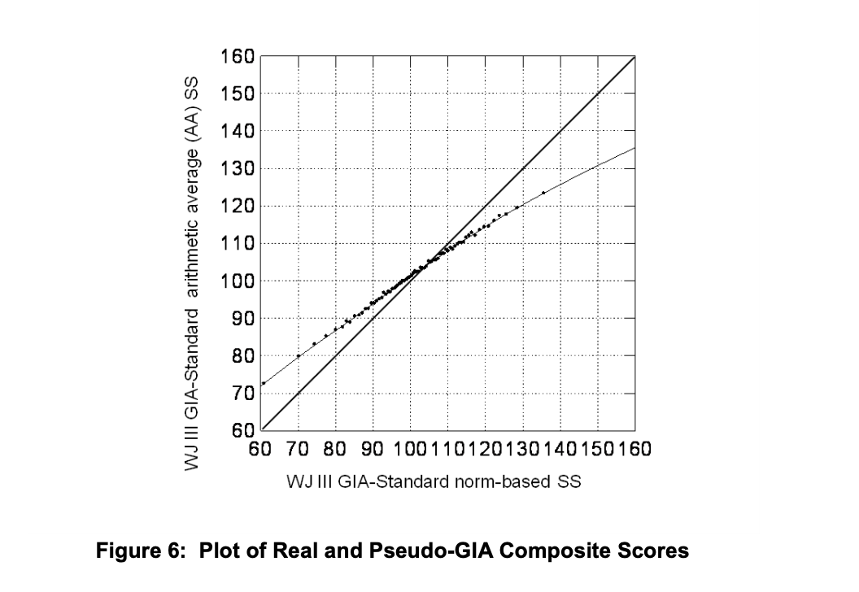
”Just Say No” Part Two (Schneider & McGrew, 2011)

Slide 30
Profile Analysis 2.0 (2000-present)

Slide 31
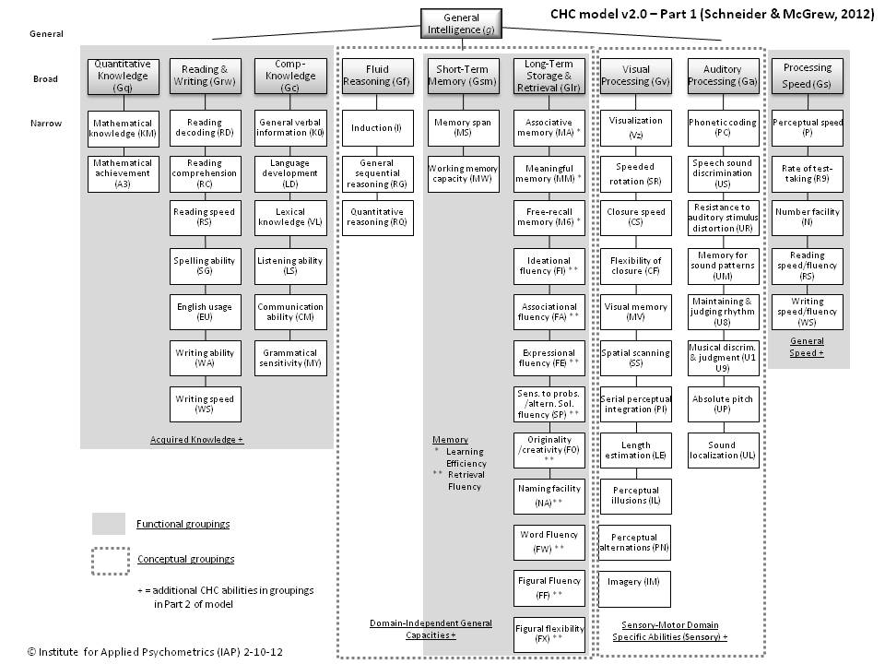
Cattell-Horn-Carroll Theory of Cognitive Abilities (Schneider & McGrew, 2012)

Slide 32
Impact of CHC on Test Development

Slide 33
CHC Citations Since 2000

Slide 34
2.0 Methods
Various Patterns of (Processing) Strengths and Weakness Methods/Models (McGill, Styck, Palomares, & Hass, 2016; Phipps & Beaujean, 2016)
1.0 Methods within Battery.
CHC-based XBA (Flanagan, Ortiz, & Alfonso, 2013)
Consistency-Discrepancy Model (Naglieri, 2011)
Concordance-Discordance/Cognitive Hypothesis Testing Model (Hale & Fiorello, 2004)
Dual/Discrepancy Consistency Model (Flanagan, Alfonso, & Mascolo, 2011)
CHC-based selective testing ([i.e., subtests], Schultz & Stevens, 2015)
C-LIM (Rhoades, Ochoa, Ortiz, 2005)
Example Software/Programs
Psychological Processing Analyzer (PPA; Dehn, 2016)
Cross-Battery Assessment Software System (X-BASS; Flanagan, Ortiz, & Alfonso, 2015)

Slide 35
Assumptions of 2.0 Approaches
Theoretical advances (i.e., CHC) enable us to make more defensible inferences from score profiles.
  Previous limitations are no longer relevant in most circumstances
Primary interpretation at the broad ability factor/composite-level
  The scores reflect legitimate psychological dimensions.
  If located, these constructs are measured well.
  Unique profiles and signs are diagnostically valid and have implications for treatment.
  Score profiles are stable over time.
FSIQ continues to be de-emphasized.
Clinicians are able to engage in complex configural analyses (McFall, 1989).

Slide 36
Psychometric and Conceptual limitations of 2.0 Approaches

Slide 37
Construct Validity: Factorial/Structural Validity (Internal Structure)
Frazier, T. W., & Youngstrom, E. A. (2007). Historical increase in the number of factors measured by commercial tests of cognitive ability: Are we overfactoring? Intelligence, 35, 169-182.
Trends for IQ tests (Frazier & Youngstrom, 2007) past 55 years-increasing number of factors claimed to be measured by IQ tests. Over-reliance on CFA procedures, use of liberal factor extraction criteria, and ”cash validity."

Slide 38
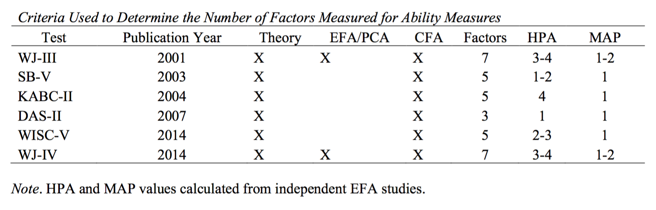
Factor Extraction Criteria for Ability Measures (more test recent versions)

Slide 39
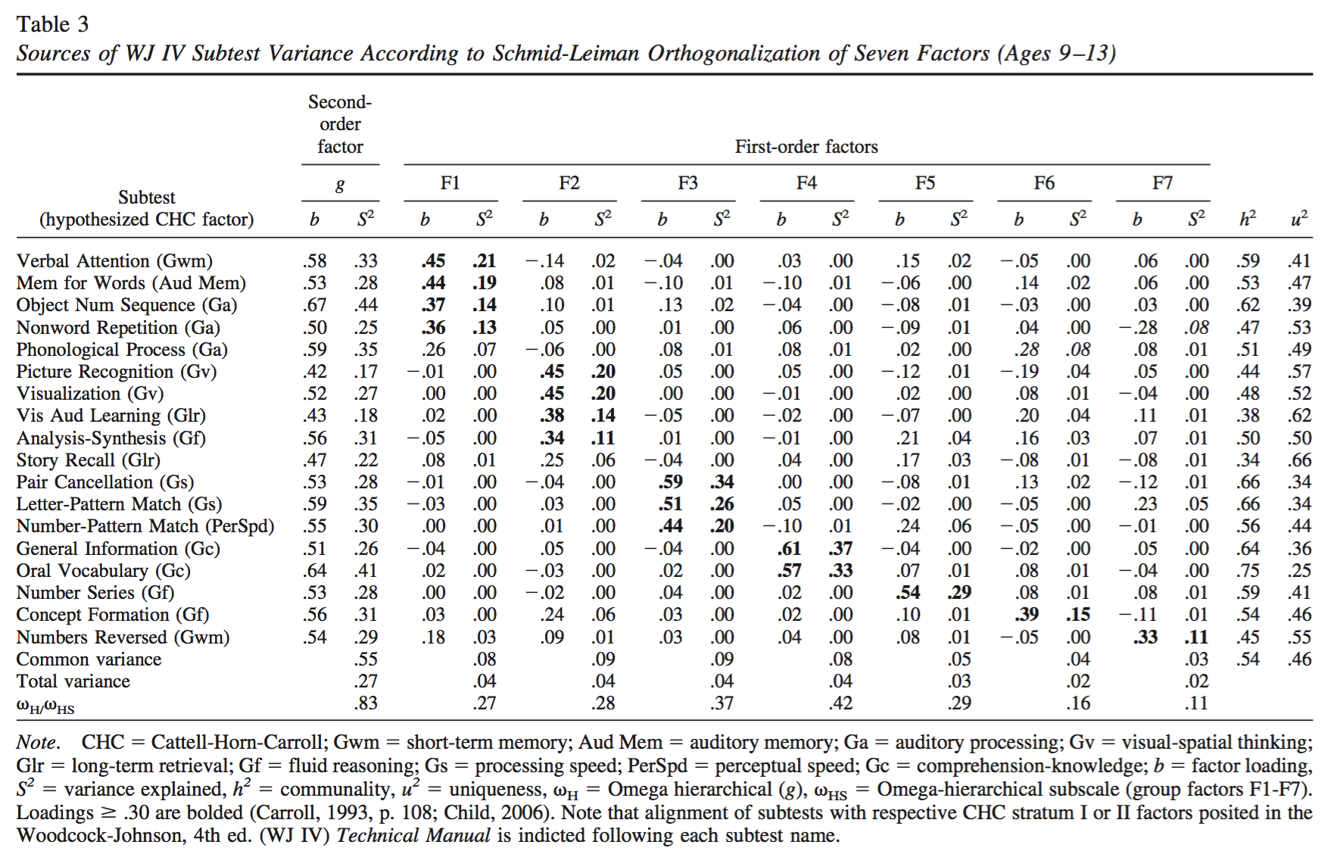
Applied EFA Example Featuring the WJ-IV (Dombrowski et al., 2018)

Slide 44
Another Potential Confound (1993;1997)

Slide 45
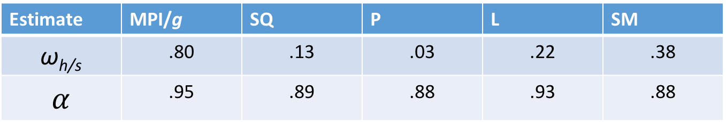
Scale Reliability
Coefficient alpha and the problem of multidimensional data (Caretta & Rhee, 2001; Chen et al., 2012).
Bifactor modeling preferred (Watkins & Beaujean, 2014).
Omega hierarchical (ω_{h}) and omega subscale (ω_{s} ).
Omega coefficients should exceed .50, but .75 is preferred (Reise, 2012; Reise, Bonifay, & Haviland, 2013).
Estimate | MPI/g | SQ | P | L | SM
ω_{h/s} | .80 | .13 | .03 | .22 | .38
$$α$$ | .95 | .89 | .88 | .93 | .88
Notes:
Results from KABC-II EFA (McGill & Spurgin, 2017).

Slide 46
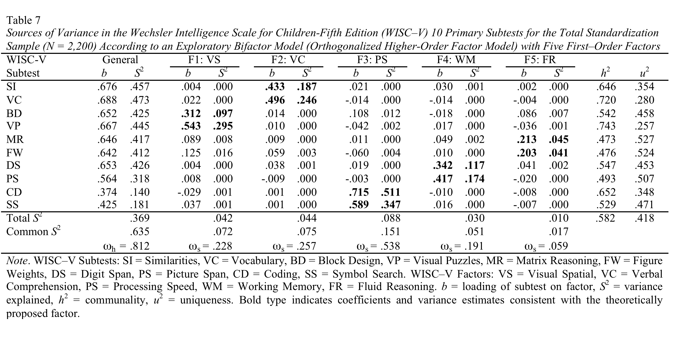
Interpret
Don’t Interpret
Maybe Interpret
Don’t Interpret

Slide 47
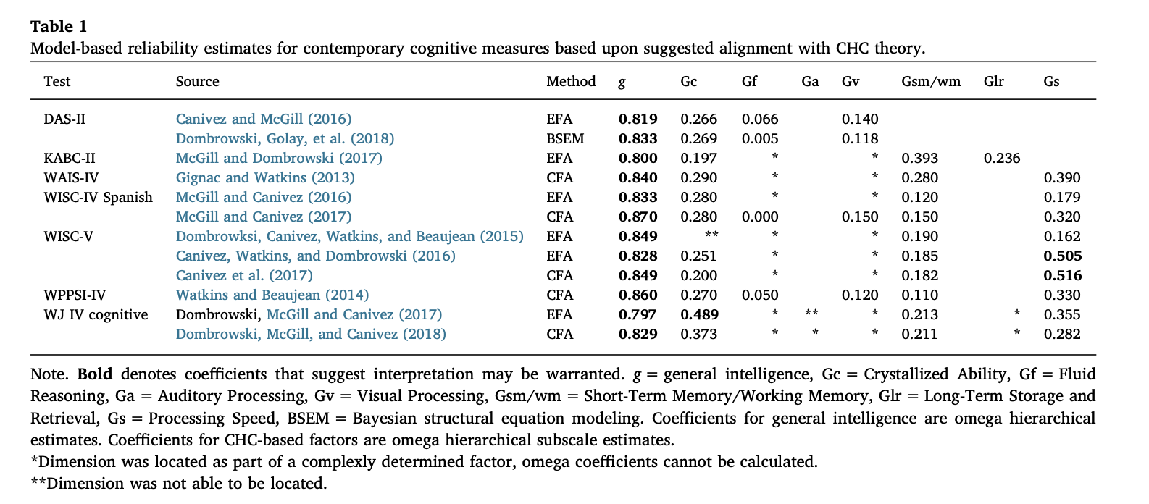

Slide 48
Stability of Composite Scores
Long-term stability of scores and unique PSWs (e.g., Watkins & Smith, 2013).
  ~30-40% of participants’ index scores fluctuated by >10 points.
Examiner bias (McDermott, Watkins, & Rhoad, 2014).
  All scores suffered from non-trivial assessor bias.
  Implications for PSW?

Slide 49
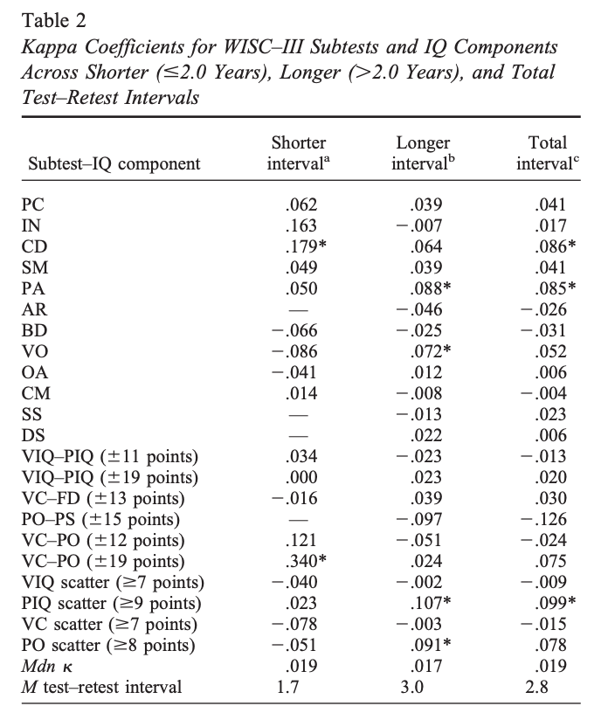

Slide 50
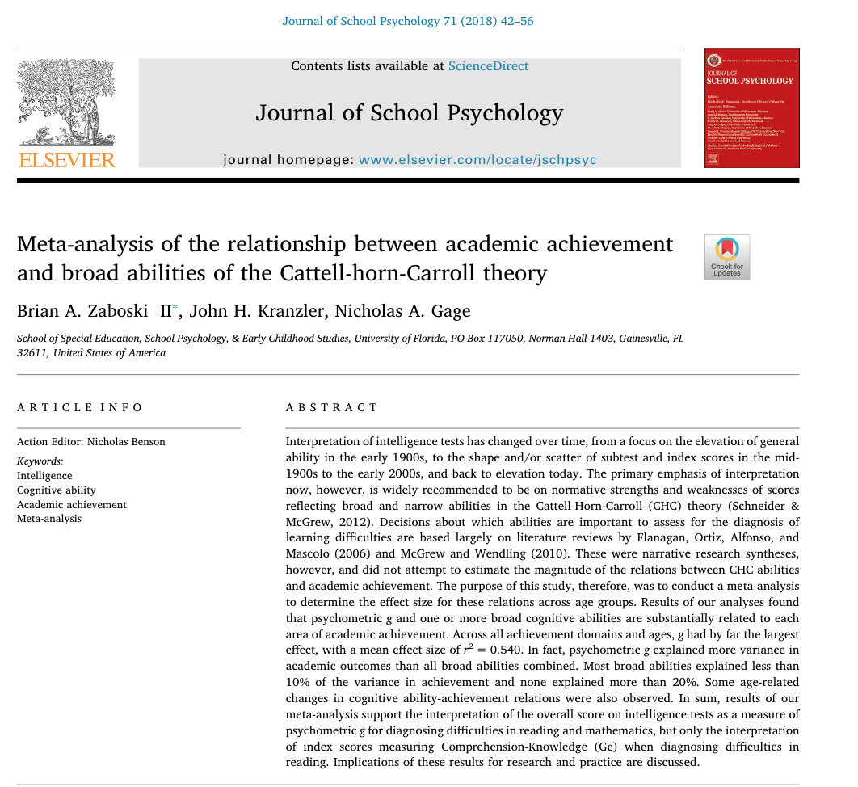

Slide 51
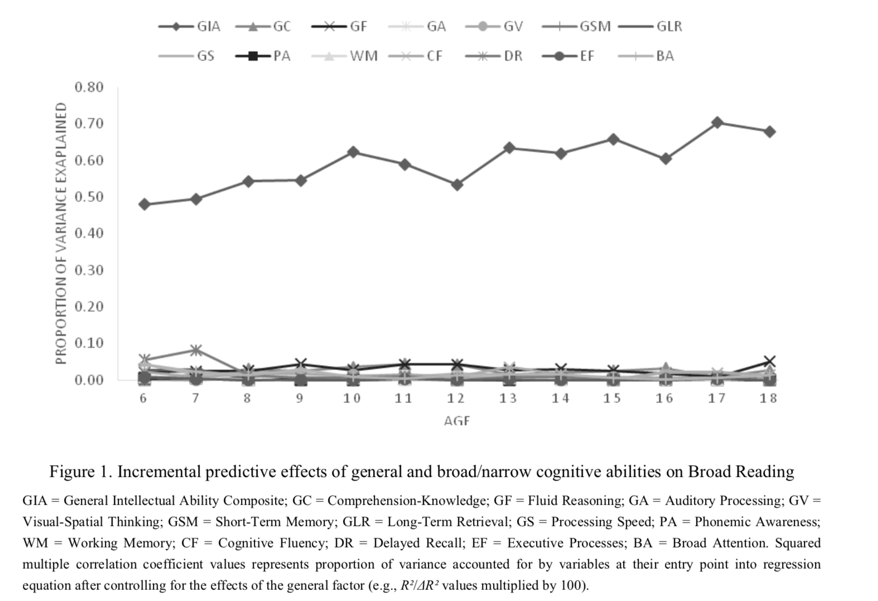
Incremental Predictive Validity

Slide 52
Diagnostic Utility
Liberal Decision Threshold
(“casting a wide net”)
 |  | PSW Decisions
 |  | SLD (i.e., PSW) | No SLD (i.e., no PSW)
True State of the World | SLD (i.e., PSW) | TP | FN
 | No SLD (i.e., no PSW) | FP | TN
Conservative Decision Threshold
(“casting a narrow net”)
Typically
Developing
SLD
High sensitivity, but low specificity
Low sensitivity, but high specificity

Slide 53
Unique Profiles as a Diagnostic Sign
Subtest profiles fail to accurately distinguish between clinical and non-clinical subgroups (e.g., Kavale & Forness, 1984; Macmann & Barnett, 1997; Watkins, 2000)
Index profiles fail to distinguish between clinical and non-clinical subgroups (e.g., Smith & Watkins, 2004; Devena & Watkins, 2012)
Illusory correlation– the false belief that two variables are related (Chapman & Chapman, 1967)

Slide 54
PSW Methods Aren’t New
Numerous patterns and profiles have been preferred over the last 40 years to identify LD (e.g. Kaufman, 1993).
  Bannatyne Profile
  ACID Profile
  SCAD Profile
  LD Index
  Cognitive scatter analysis

Slide 55
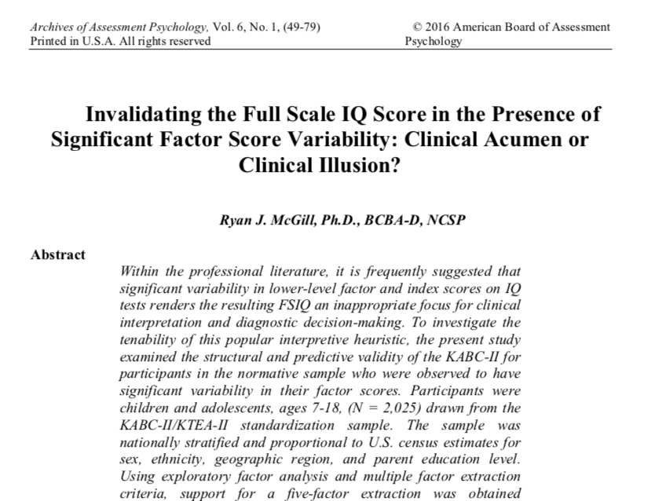
Does Scatter Matter (McGill, 2016; 2018)?
Presently there is no compelling evidence to indicate that scatter impacts the structural or predictive validity of composite scores. No evidence that scatter is a useful diagnostic sign for LD.
As a result, Kaufman, Flanagan, and, to some extent, Sattler have no de-emphasized the use of scatter analysis in recent writings (sort of).

Slide 56
Is Test Scatter Useful at Any Level?
Notes:
Diagnostic utility statistics (e.g., Kessel & Zimmerman, 1993) were also computed for different thresholds of scatter using the Diagnostic Utility program by Watkins (2002). A number of attributes of a test, collectively known as diagnostic efficiency statistics, can be derived from these numbers. The sensitivity of a test is defined as the proportion of people who have SLD who are detected by the test. The specificity of a test is the proportion of people without SLD who are correctly labeled by the test. Sensitivity and specificity can be combined into a single number called the likelihood ratio (LR). According to Streiner (2003), LR+ and LR- that are $≥$ 1 indicate the test is useless as a rule-in/out indictor of an attribute. Positive predictive power and negative predictive power refer to the ratio of individuals who are correctly classified as having SLD based upon the presence or absence of meaningful scatter.
Diagnostic utility statistics for increasingly higher increments of cognitive profile scatter are presented in Table 2. At all levels, diagnostic accuracy failed to exceed chance (AUCs from .47 to .51). However, negative predictive values were consistently strong suggesting that the absence of cognitive scatter may function well as a potential rule-out test for the presence of SLD. However, the positive predictive values at all levels of scatter (.04 to .05) were hopelessly weak indicating that scatter did not function as a useful rule-in test for SLD.

Slide 57
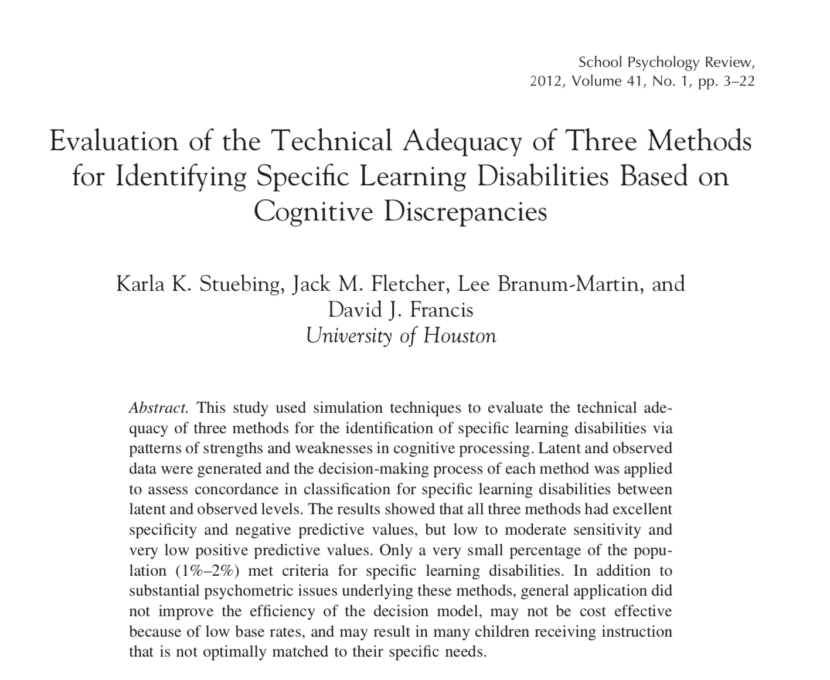
Diagnostic Utility of PSW
These findings have been replicated in every subsequent study examining DV of various PSW methods and permutations (Kranzler et al., 2016, 2019; McGill, Conoyer, & Fefer, 2018, Miciak et al., 2014, Miciak, Taylor, Denton, & Fletcher, 2015; Taylor, Miciak, Fletcher, & Francus 2017).
No comparable study reporting positive findings has been produced.
Factors that degrade decision utility:
  Test selection.
  More assessment.
    Dilution effect (Faust, 1989; Nisbett et al., 1981)
Simulated 5,000 cases of assessment data and evaluated technical adequacy of C/DM, D/CM, and DD/C methods.
Poor overlap between methods.
1%-2% base rate.
Excellent NPV, very low PPV.

Slide 58
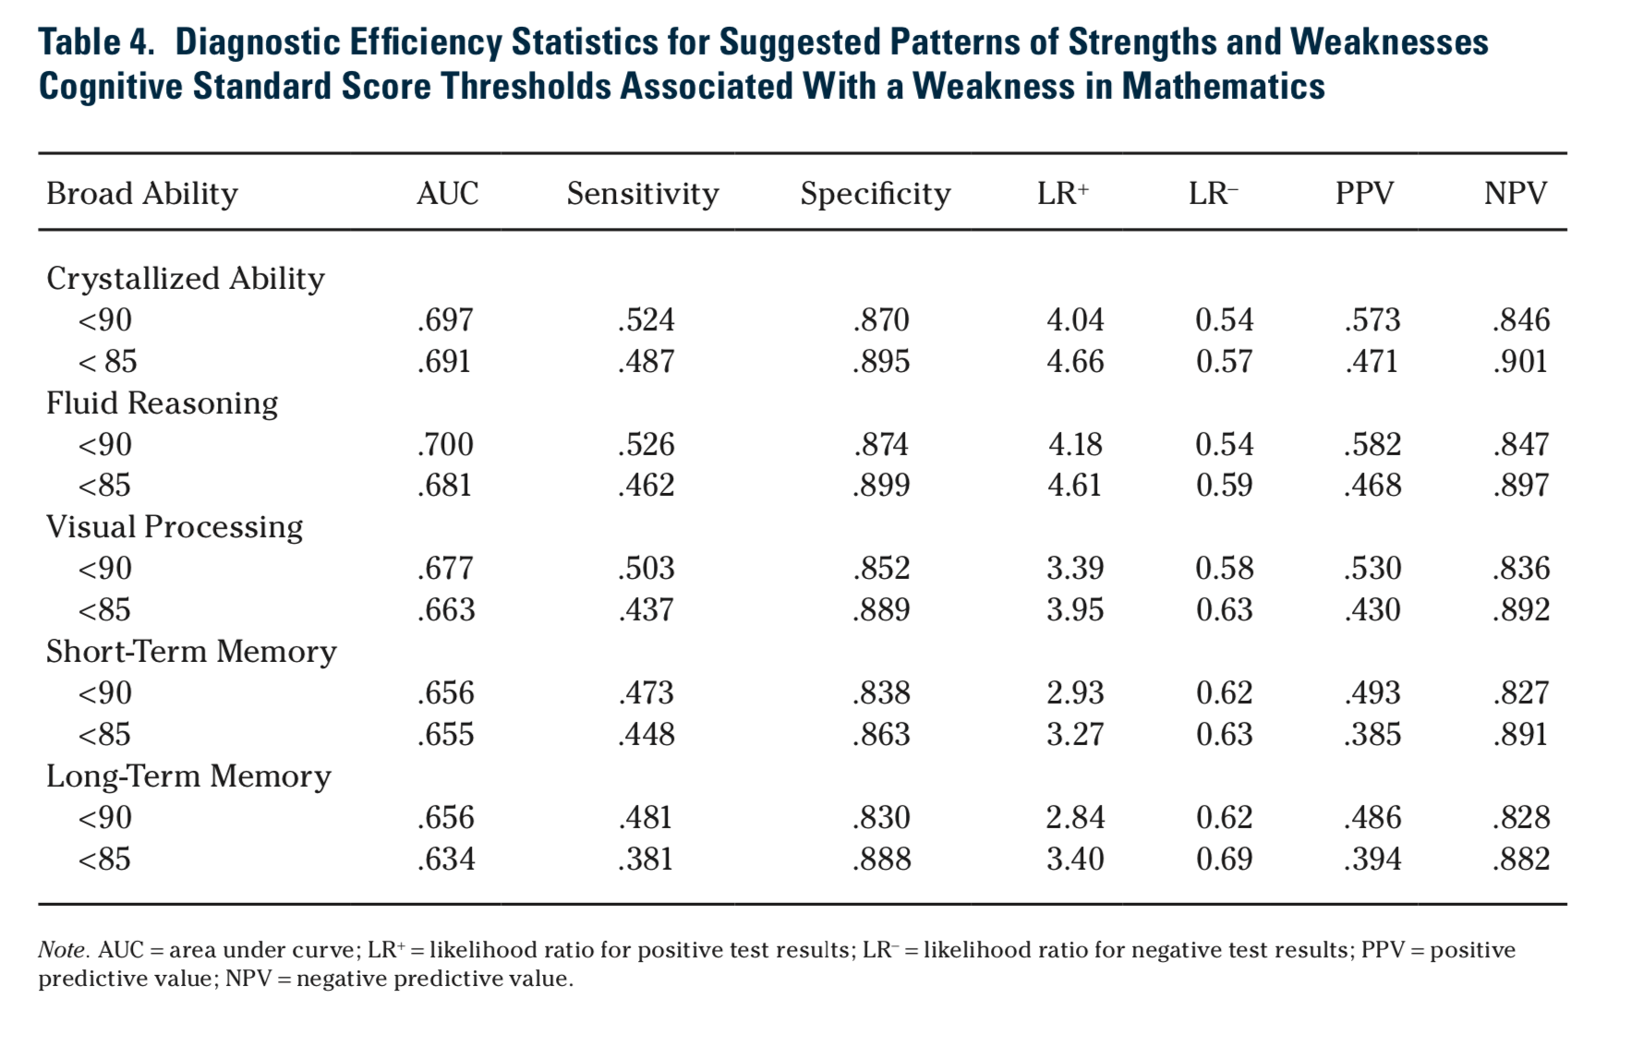
McGill, Conoyer, & Fefer (2018)

Slide 59
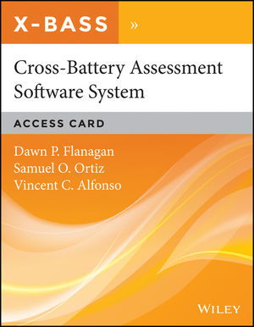
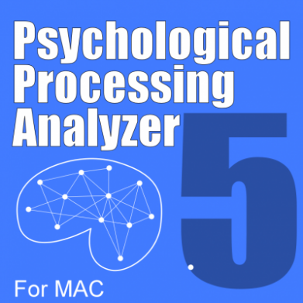
Issues with PSW/XBA Software
Pairwise comparisons and reliability of difference scores (Edwards, 2001)
Score comparisons are not conservative tests.
  SE diff (McGill et al., 2016)
  Multiple comparisons/Type I error
Correlations between measures
  Disclosure
  Adequate updating
  Sample sizes
Subjective judgement
Absence of diagnostic utility information (Kranzler et al., 2016)
Notes:
Where are they getting the correlations from?

Slide 60
Reliability of Difference Scores
DIFF scores are always less reliable than there constituent parts.
Test A (.90); observed score = 100
Test B (.90); observed score = 77
Correlation between Test A and Test B (.75)
Reliability of difference score (.60); observed difference = 23
~95% CI for difference score = (4-42)

Slide 61
Is PSW Evidence-Based?
“Flanagan and colleagues first presented their initial operational definition of SLD almost 15 years ago (Flanagan, Ortiz, Alfonso, & Mascolo, 2002). Have the proponents of the XBA PSW method evaded peer review since then? What evidence has been published in the peer-reviewed literature to support the PSW methods? According to results of a PsychINFO search of the principal authors of the XBA PSW approach, we found only two articles that were published in peer-reviewed journals since 2001 and both were “thought pieces” and not empirical studies (viz., Decker, Hale, & Flanagan, 2013; Flanagan, Ortiz, Alfonso, & Dynda, 2006). Employing such search terms as “patterns of strengths and weaknesses,” “dual discrepancy/consistency method,” and “cross-battery assessment” resulted in numerous hits for most terms, but few peer-refereed journal articles reporting empirical research. Moreover, the empirical research that has been published in journals does not support the XBA PSW method (Miciak et al., 2014; Stuebing et al., 2012).”

Slide 62
Treatment Utility: Can 200 Studies Be Wrong?

Slide 63
Schneider & Kaufman (2017)
Most defenders of the role of cognitive assessment in the diagnosis and treatment of learning disabilities believe that a comprehensive cognitive assessment is essential and that knowing about a person’s cognitive abilities leads to better decisions about interventions (Hale et al., 2010). After rereading dozens of papers defending such assertions, including our own, we can say that this position is mostly backed by rhetoric in which assertions are backed by citations of other scholars making assertions backed by citations of still other scholars making assertions. There is nothing wrong with making and citing assertions, but to confuse such assertions with epistemological bedrock is to be epistemologically confused and groundless” (p. 8).

Slide 64
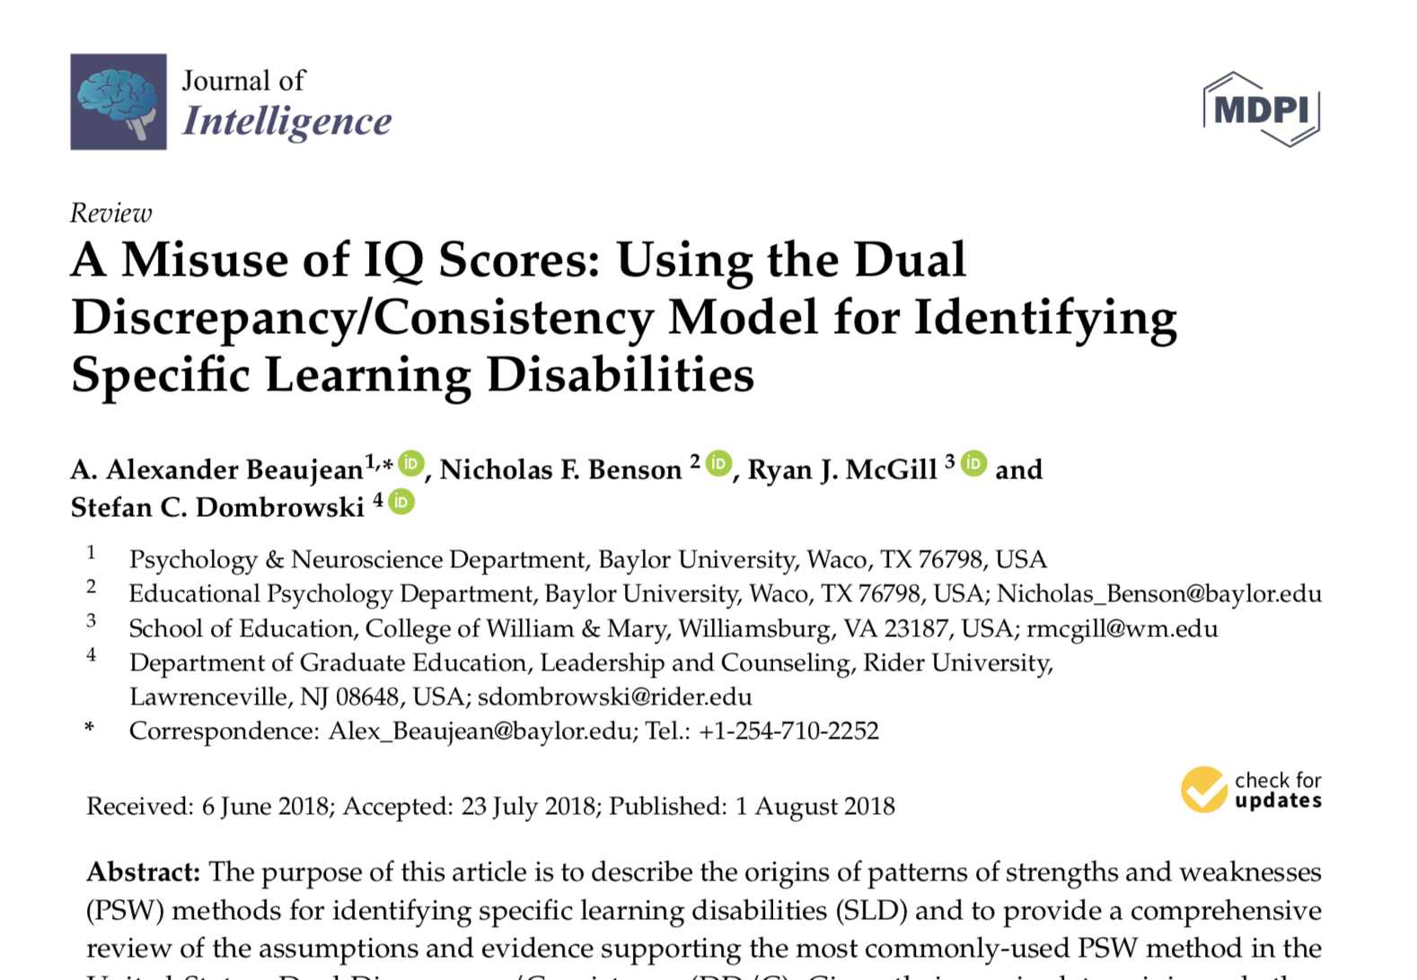
The Additivity Problem (Beaujean et al. 2018)

Slide 65
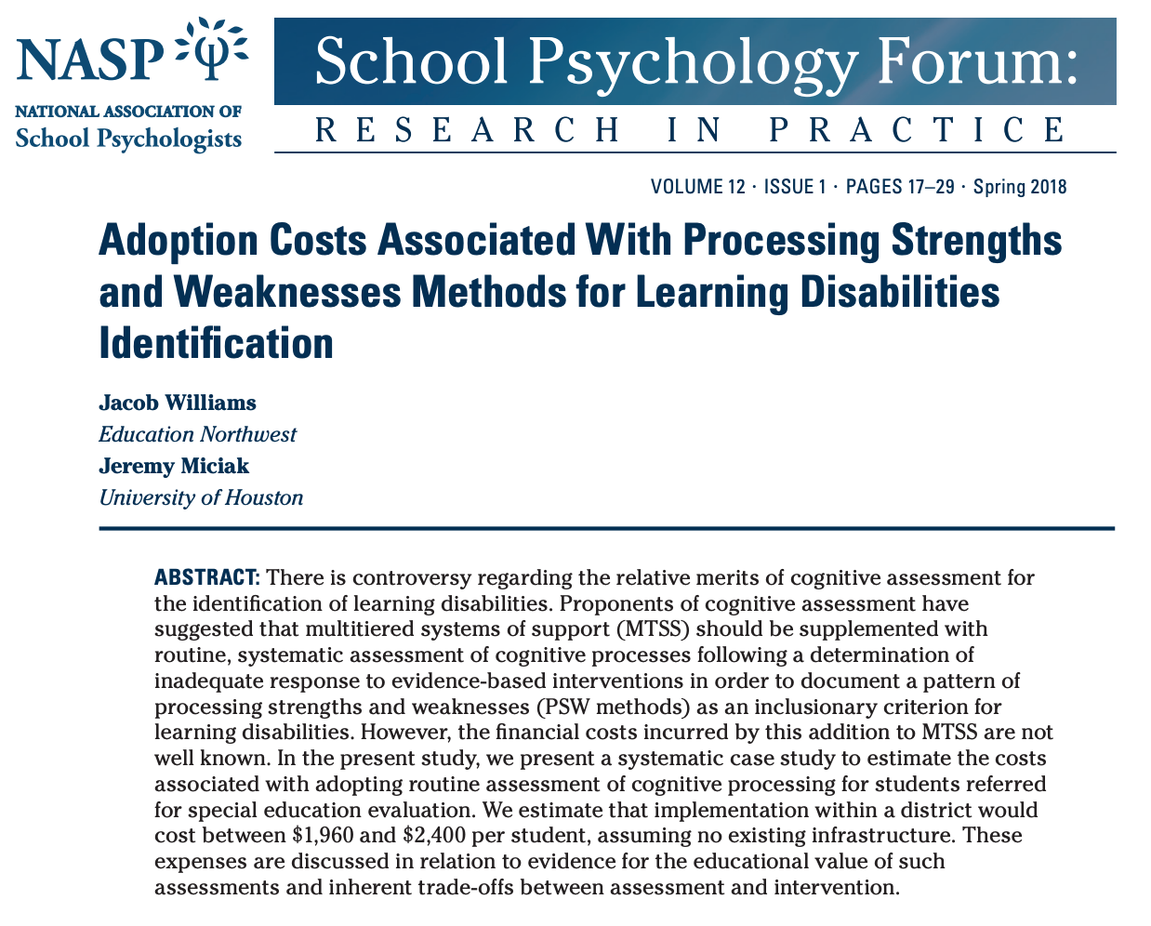
Are Profile Analysis Methods Cost Effective?

Slide 66
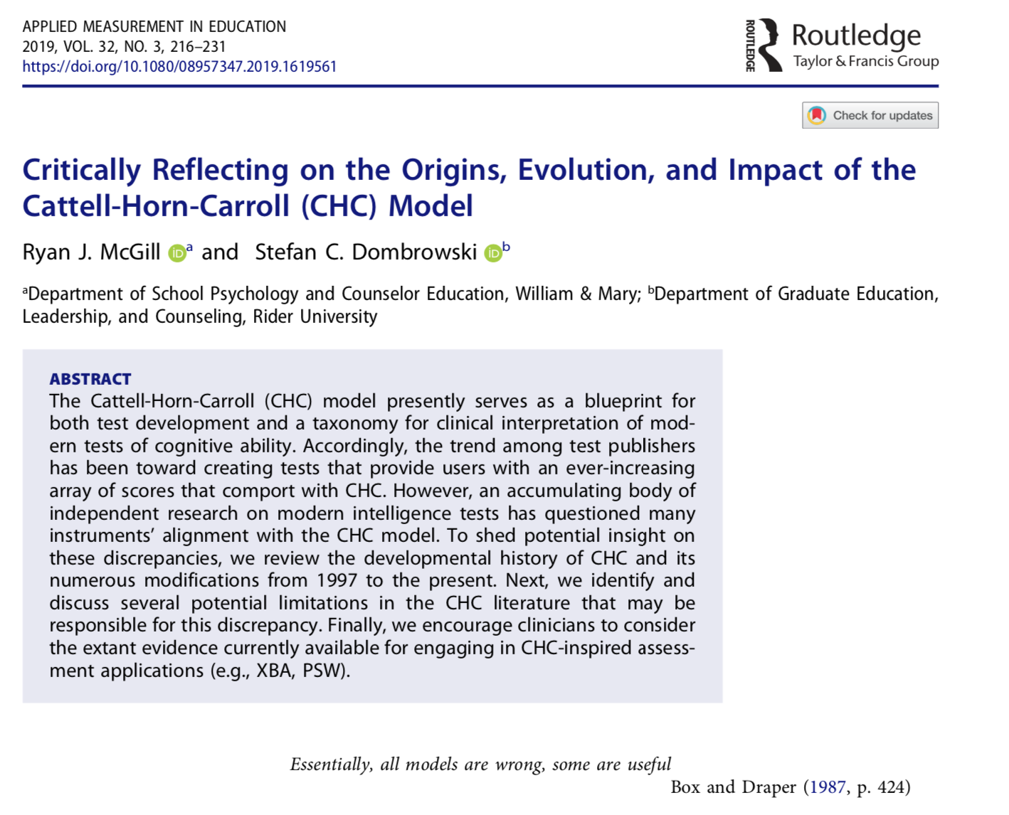
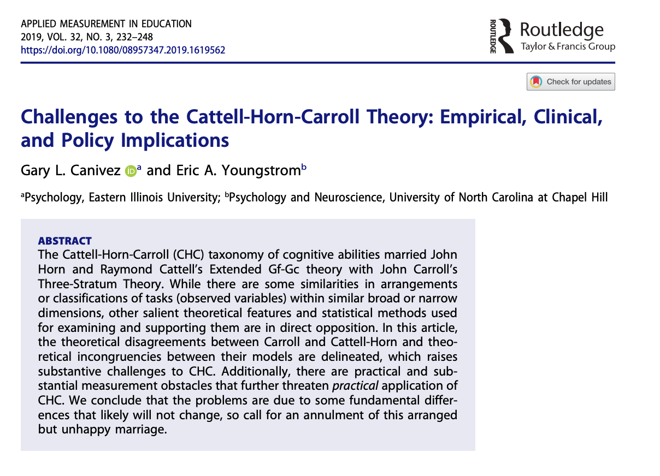
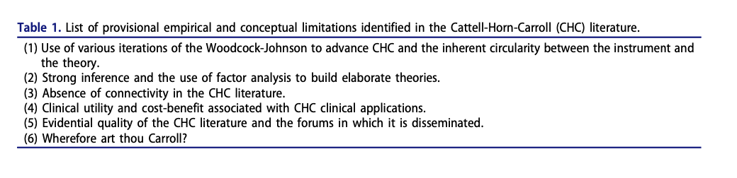
Is CHC a Viable Theory? AME Special Issue (Geisinger, 2019)

Slide 67
Wherefore Art Thou Carroll? (McGrew, 2014)
Where is g ?

Slide 68
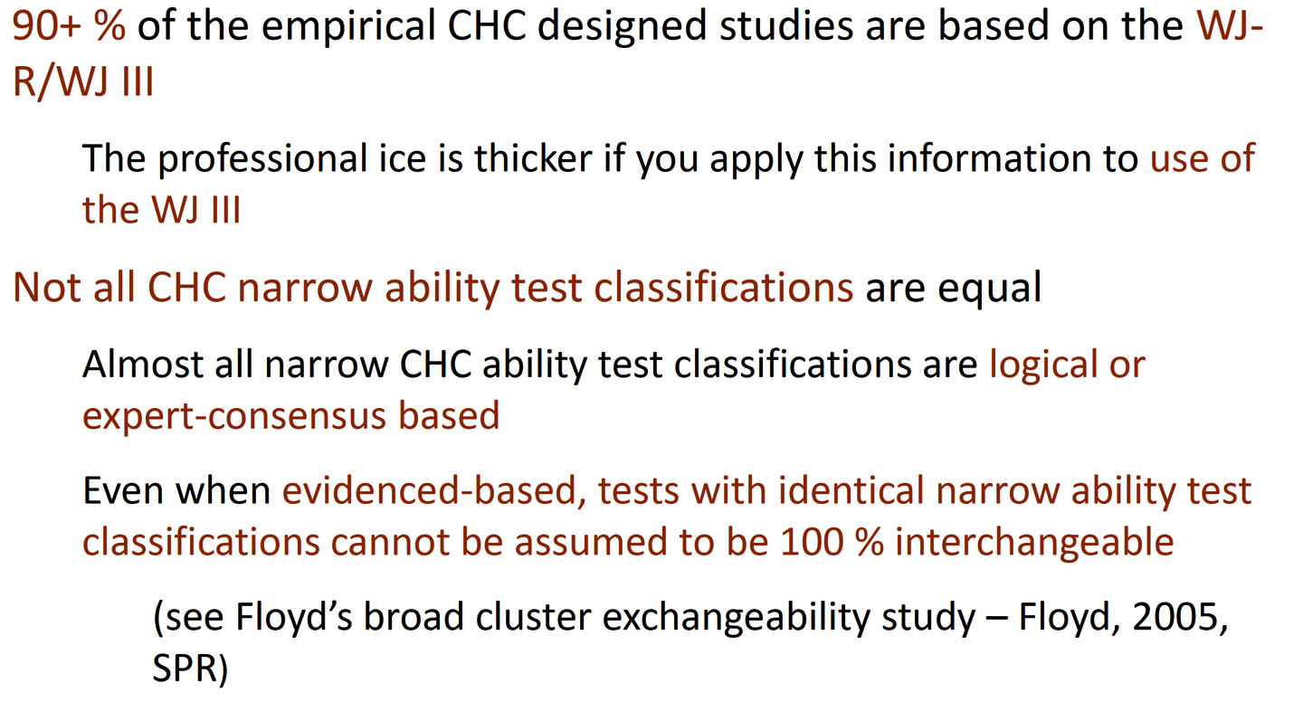
Using CHC Theory to Inform XBA Interpretation
McGrew, K. S. (2014). CHC Theory & Assessment: Best practices and what we've (I've) learned in the past 25 years. Powerpoint slides retrieved from http://conference.esc13.net/assets/hci14/docs/McGrewAM_HCI14.pdf

Slide 69
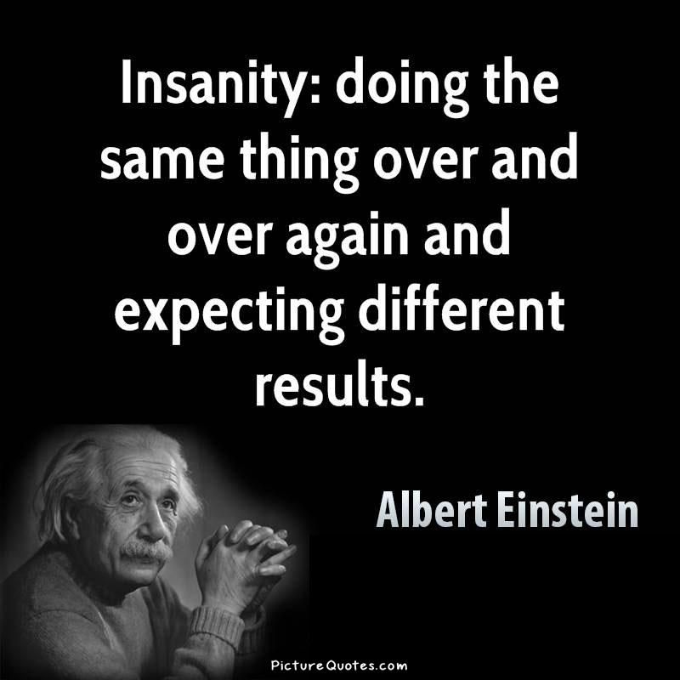
Are Profile Analysis Methods Impervious to Scientific Debunking?

Slide 70
How Popular is Profile Analysis?
Contemporary surveys continue to indicate that it remains extremely popular among practitioners (Benson et al., 2018; Sotelo & Dynega Dixon, 2014).
  ~50-70% of respondents report using index-level profile analysis on a routine basis.
  Over 25% indicate that they continue to interpret subtest-level profiles.
  Over half indicate that they rely exclusively on the levels-of-analysis approach championed by Kaufman and Sattler.
  46% indicate that they never interpret the FSIQ when there is significant scatter.
~70% of training programs emphasize intelligent testing and/or XBA.
PSW models are gaining significant momentum in developing countries for the identification of SLD.

Slide 71
Interpretive Guidance in Popular Texts (McGill & Canivez, 2019)

Slide 72
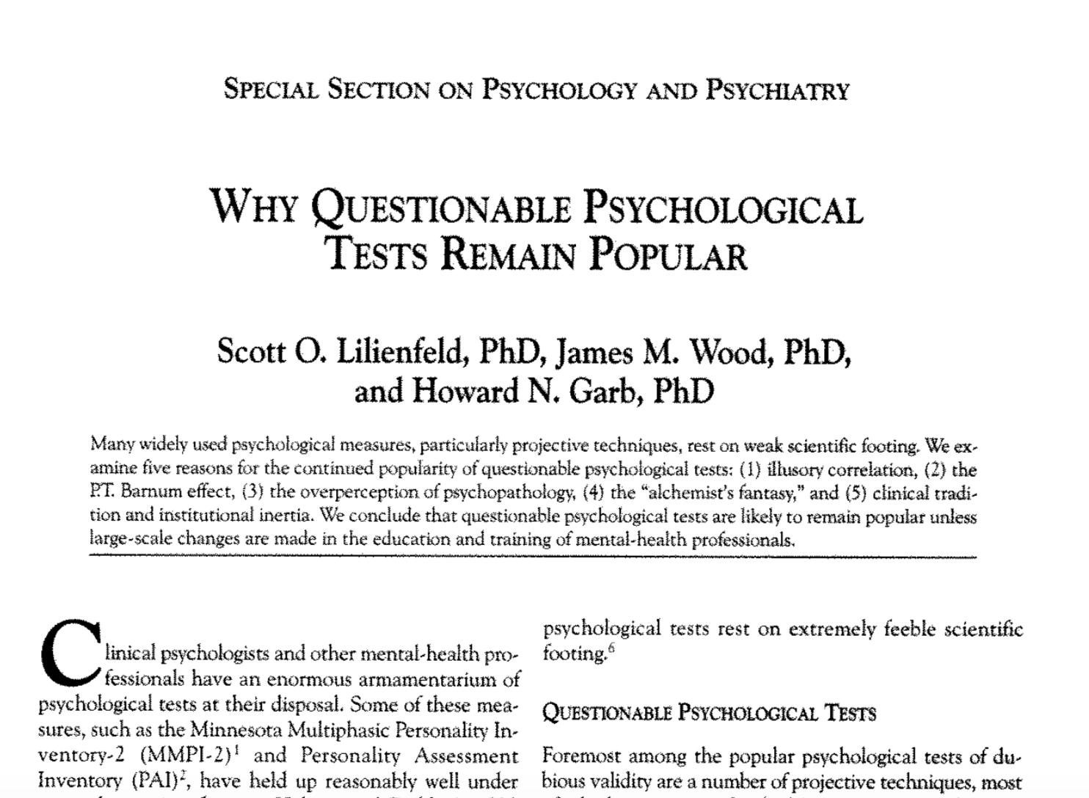

Slide 73
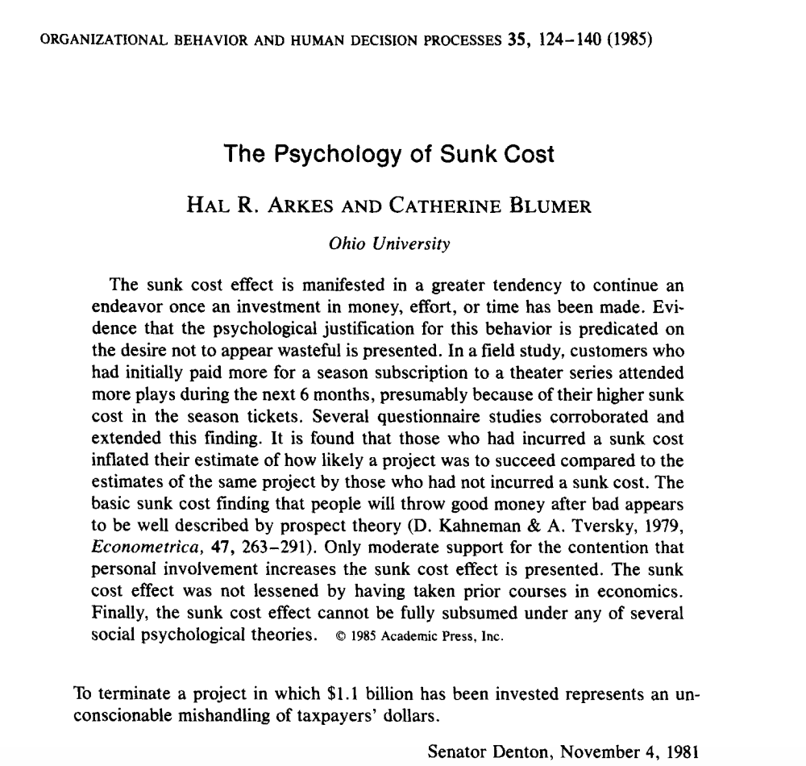
Sunk Cost Fallacy

Slide 74
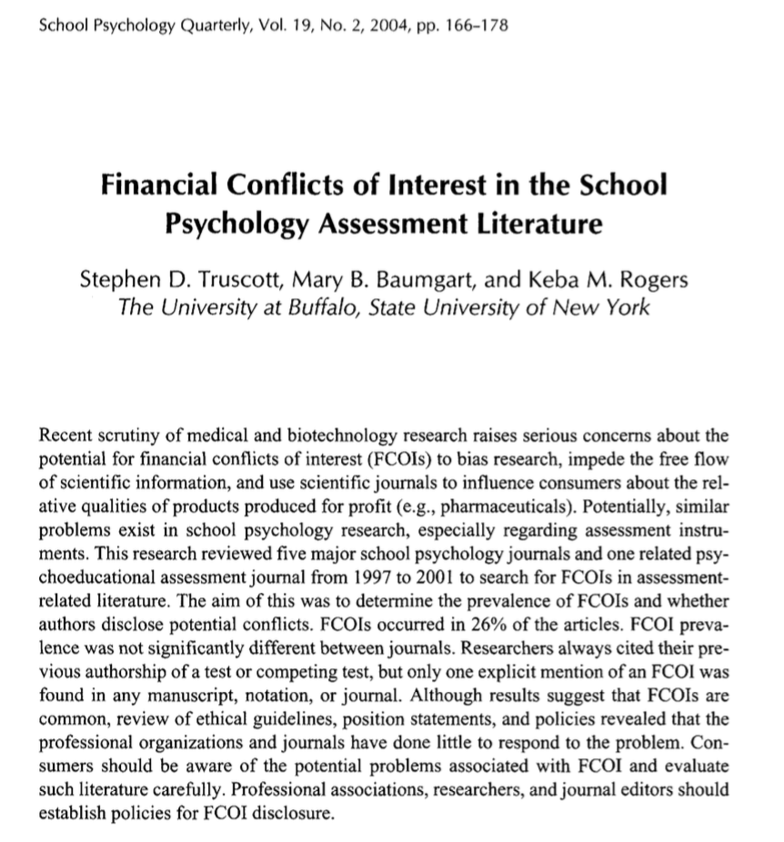
Potential Financial Conflicts of Interest

Slide 75
Reflecting on the State of “Intelligent Testing” in the Field
“I am convinced by recent papers showing WJ is a one-factor test, the lack of evidence for cross battery assessment, the expansion of the number of subtests in WISC-V, the over-emphasis on subtest analysis, the illusion that subtests can be combined across tests without regard for differences in standardization samples, the view that someone can look at a test and decide what it measures, the misuse of factor analysis of WISC subtests old and new to decide the structure of intelligence, and the over-interpretation of tests from a ‘neuropsychological’ perspective that our field has gone down a path that will not help children” (Naglieri, personal communication, as cited in Kaufman, Raiford, & Coalson, 2016 pp. 18-19).

Slide 76
Concluding Thoughts
A number of measurement issues continue to complicate the use of any variant of cognitive profile analysis.
  Adequate disclosure?
Theory is not a type of validity.
“Clinical judgement” as magical incantation.
  High validity environment.
  Systematic feedback.
  Lake Woebegone.
Things that are intuitively appealing require strong forms of evidence due to our propensity for confirmation bias (Nickerson, 1998).
Implications for informed consent (Posada, 2004).
“He that forsakes measure, measure forsakes him”
-Scottish Proverb

Slide 77

Where Do You Go From Here?
Notes:
Stipulate that many work in practice environments where they don’t have a choice but even in those circumstances there is sufficient freedom to vary (i.e., black box warning).

Slide 78


Contact Information:
Ryan J. McGill, Ph.D., BCBA-D, NCSP
Assistant Professor of School Psychology
William & Mary School of Education
Professional Website: www.rjmcgill.com
E-Mail: rmcgill@wm.edu

