Slide 1
The Role of the School Psychologist
YOUR DISTRICT NAME HERE
Your name, Your school site(s)
Date

Slide 2
The 10 domains a school psychologist practices
1. Data-based decision making
2. Consultation and collaboration
3. Academic interventions and instructional support
4. Mental and behavioral health services and interventions
5. School-wide practices to promote learning
National Association of School Psychologists. About the NASP Practice Model. https://www.nasponline.org/standards-and-certification/nasp-practice-model
Notes:
Examples:
Knowledge of the most appropriate assessment tool
Working with family therapists, military liaisons, etc.
Knowledge of evidence-based curricula and instructional strategies
Knowledge of behavioral and emotional impacts on learning and life skills
Knowledge of technology resources, etc.

Slide 3
The 10 domains a school psychologist practices
6. Services to promote safe and supportive schools
7. Family, school, and community collaboration
8. Equitable practices for diverse student populations
9. Research and evidence-based practice
10. Legal, ethical, and professional practice
National Association of School Psychologists. About the NASP Practice Model. https://www.nasponline.org/standards-and-certification/nasp-practice-model
Notes:
6. Evidence based strategies for effective crisis response
7. Strategies to develop collaboration between families and children
8. Knowledge of individual differences, abilities, disabilities, and other diverse student characteristics
9. Knowledge of statistics and varied data collection and analysis techniques
10. Knowledge of ethical, legal and professional standards

Slide 4
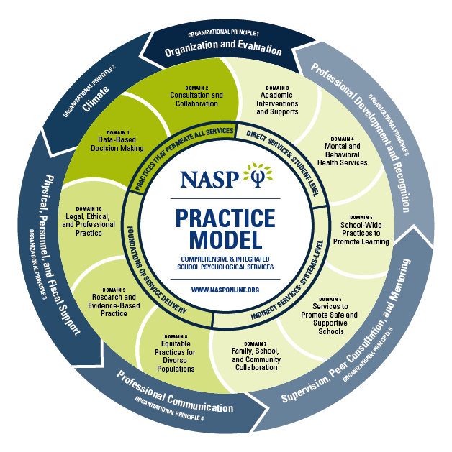
NASP Practice Model

Slide 5
School psychologists help to support:
Age-appropriate development
Such as school readiness; developmental characteristics for physical, intellectual, social, and emotional
Academic achievement and learning
Work with teachers to provide strategies and interventions for remedying barriers to learning
Social/emotional wellness
Work with administrators, teachers, students and their families to support development of problem solving and self-regulation skills.
Evidence-based school practices
Research design, statistics, measurement, data collections and analysis techniques
Legal and ethical procedures and practices
Using ethical, legal and professional standards
Modified from National Association of School Psychologists. NASP Practice Model: 10 Domains of Practice. http://www.nasponline.org/standards/practice-model/. Web 15 May 2015.

Slide 6
School Psychologists work with:
Students
Teachers
Special education team members (SLPs, OTs, PTs, SpEd Teachers)
Parents/families
Administrators
Counselors
Community agencies
Private therapists and medical providers

Slide 7
Working with students and their families to:
Identify and address learning and behavioral difficulties
Evaluate need and eligibility for special education services within a multidisciplinary team
Support students’ social, emotional, and behavioral health
Notes:
Talking point: While school psychologists can do all of these things, depending on the team and community there will be differences. For example, one school psychologist may work more closely (monthly meetings about this or quarterly review of data with another school) than another with their teams to create interventions or analyze school and system data for PBIS/RTI.

Slide 8
Working with teachers to:
Identify barriers impacting student learning and performance at school
Develop academic, social/emotional, and behavioral interventions
Monitor progress and implementation of plans with fidelity
Notes:
School psychologists are able to do skilled observations that give insight into identifying barriers impacting student learning and performance in school

Slide 9
Working with multidisciplinary team members to:
Gather data and information to determine student need for special education evaluation when a referral has been made
Obtain present levels of academic achievement and functional performance through evaluation procedures
Analyze evaluation information and data to determine need and eligibility for special education services
Notes:
Talking point:
What data and information need to be included for a referral to be considered?
How students qualify/DNQ?

Slide 10
Working with multidisciplinary team members to:
Develop intervention plans and progress monitoring measures
Organize and facilitate regularly scheduled team meetings to monitor, organize, and plan for upcoming evaluations to meet legal timelines
Notes:
Regularly reviewing progress to determine if an intervention plan is working and/or if modification to the plan are needed – then make those changes accordingly

Slide 11
Work with administrators to:
Analyze data related to MTSS for academic and behavior skills
Determine school-wide needs to support student success
Provide and support evidence-based strategies for effective crisis response

Slide 12
Promote legal, ethical, and professional practices
School psychologists oversee special education evaluations to ensure legal, ethical, and professional practices are implemented at the building level
Helping schools meet legal requirements established by the No Child Left Behind Act of 2001 and the Individuals with Disabilities Education Improvement Act of 2004

Slide 13
Psychological evaluation professional
Areas of evaluation
Cognitive
Academic
Social/Emotional development
Social skills
Executive functioning
Adaptive skills
Vocational skills

Slide 14
School Psychologist Contact Information
Your Office Location
Your days/times at that office
List information for teams you participate in such as pre-referral or MTSS teams
Add a picture of yourself to the right.
Notes:
Add text specific to your school

Slide 15
References
National Association of School Psychologists. About the NASP Practice Model. https://www.nasponline.org/standards-and-certification/nasp-practice-model/about-the-nasp-practice-model
National Association of School Psychologists. Professional Standards & Training. http://www.nasponline.org/standards/practice-model/. Web 5 May 2015.
National Association of School Psychologists. School Psychologists: Improving Student and School Outcomes. http://www.nasponline.org/standards/practice-model/. Web 15 May 2015.
National Association of School Psychologists. Who Are School Psychologists? http://www.nasponline.org/about. Web 13 April 2015.

